Slide 1
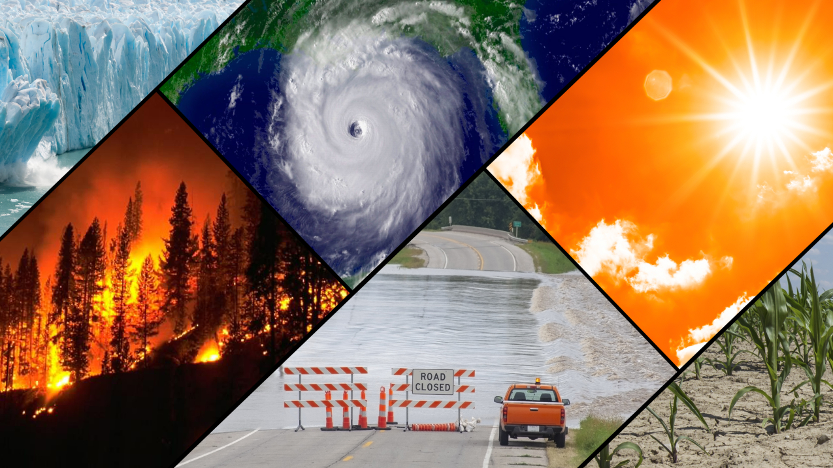
Around the World – Year 6 - How does weather and climate affect different parts of the world?
Discussion Topics and Enquiry Questions
1 | What is the difference between weather and climate?
2 | Why do different countries experience different weathers?
3 | How are the climates different around the world?
4 | What affects climate change?
5 | How are the polar regions similar/different to other regions around the world?
6 | What was the importance of different polar expeditions?
Sentence Stems
I agree with… because… I disagree with… because… I would like to challenge the view… Adding onto …’s point… In my opinion… I know this because…
Oracy Skills
Social To be able to present information fluently and confidently | Cognitive To construct a detailed argument and respond to more complex questioning
Linguistic To respond using sophisticated sentence stem and give evidence support their suggestions | Physical To respond positively to others who may disagree with our opinions
Key Vocabulary
Polar regions | Arctic | Climate | Ocean currents
Antarctic | Habitat | Polar | Coastal
Grid References | Predator | Tundra | Carbon emissions
Latitude | Longitude | Temperate | Tropic of Cancer
Producer | Biome | Mediterranean | Tropic of Capricorn
Temperature | Equator | Tropical | Precipitation
Recommended Reads
Arctic Star – Tom Palmer Shackleton’s Journey – William Grill Ernest Shackleton – Little People, Dream Big Sky Song – Abi Elphinstone The Polar Bear Explorers’ Club – Alex Bell & Tomislav Tomic

Slide 2
Core knowledge and skills
Geography: Identify key geographical lines on a world map e.g. lines of longitude and latitude. Understand that with invisible lines we can locate countries around the world with ease. Identify weather types and climates. Link climates with zones around the world. Identify what affects climate in order to associate with climate change and impact on our current world. Look at weather measuring tools and compare and evaluate effectiveness. Focus on the Polar Regions and compare to other regions around the world. History: Look at different Polar expeditions and why they were so important. Research the explorers and what the discovered. Science: Understand that light travels in a straight line and use this to explain how objects are seen. Learn how we see things because light travels from light sources and about how shadows have the same shape as the objects which cast them. Identify and name the main parts of the human circulatory system and describe the functions of the main parts. Recognise the impact of diet, exercise, drugs and lifestyle on the way our bodies function.

