Slide 1
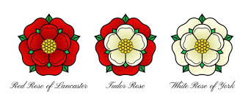
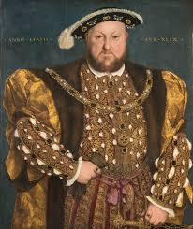
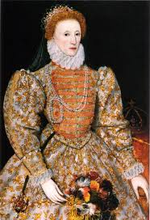




The Tudors
Discussion Topics and Enquiry Questions
1 | How have the Tudor monarchs of England shown their legacy?
2 | Can we use artefacts to tell us more about the person?
3 | How did the Tudor era start and end?
4 | How did Henry’s personal and religious beliefs cause him to act in a particular way?
5 | Why did Henry VIII have so many wives?
6 | Can you describe how the Tudors lived their everyday life including those from rich and poor backgrounds?
Key Vocabulary
peasantry | legacy | treason | Reformation | tapestry | reign
heir | execution | Noble | voyage | Catholic | Protestant
Sentence Stems
I agree with… because… I disagree with… because… I would like to challenge the view of… Adding onto …’s point… In my opinion, this source shows… I can support my answers with…
Oracy Skills
Social To be able to present information fluently and confidently | Cognitive To construct a detailed argument and respond to more complex questioning
Linguistic To respond using sophisticated sentence stem and give evidence support their suggestions | Physical To respond positively to others who may disagree with our opinions
Recommended Reads
Diver’s Daughter: A Tudor Story by Patrice Lawrence Horrible Histories: Terrible Tudors The Queen’s Fool by Ally Sherrick Treason by Berlie Doherty

Slide 2
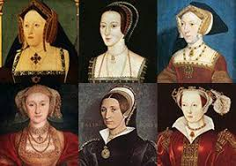
The Tudors
Sticky Knowledge
Understand the Battle of Bosworth and how it started the Tudor era. Look at the chronological events which happened in the Tudor era. Look at monarchs Henry VII, Henry VIII, Mary I and Elizabeth I and create comparisons with King Charles III. Look at all of Henry’s wives and discuss their differences and stories. Explore how Henry VIII changed the church system through his personal and religious beliefs. Look at portraits, including those completed by Hans Holbein, as they were a popular choice of Art for those who were wealthy. Look at the relevance of the Mary Rose within the Tudor era and explorers such as Francis Drake. Look at the everyday lives of those who lived in the Tudor era including jobs, housing, food, theatre. Look at what we use today which started in the Tudor era.
Core knowledge and skills
History: changes to Britain in the Tudor era, the changing power of monarchs looking at case studies, changes in an aspect of social history, such as crime and punishment and leisure Art/D&T: Learn to sketch from observation. Learn about the artist (Hans Holbein) and use his Art techniques. Create a model of the Mary Rose, sew a section of a tapestry piece and construct a Tudor food item.

