Slide 1
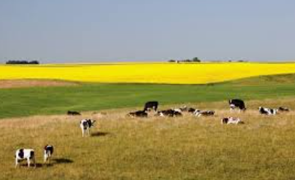
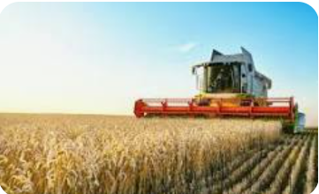




Farming
Discussion Topics and Enquiry Questions
1 | What types of farming are there in the UK?
2 | How does farming provide foo and resources for people?
3 | How does climate affect change in the landscape?
4 | How do artists show farms and countryside landscapes?
5 | Why is farming important to people’s lives?
6 | How can farming become more sustainable for the future?
Sentence Stems
I agree with… because… I disagree with… because… I would like to challenge the view of… Adding onto …’s point… In my opinion, this source shows… I can support my answers with…
Key Vocabulary
agriculture | Crop | Livestock | Arable farming | Pastoral farming | Sustainable
Mixed farming | Hill farming | Dairy and Cattle farming | Harvest | Irrigation | Fertiliser
Oracy Skills
Social To be able to present information fluently and confidently | Cognitive To construct a detailed argument and respond to more complex questioning
Linguistic To respond using sophisticated sentence stem and give evidence support their suggestions | Physical To respond positively to others who may disagree with our opinions
Recommended Reads
Last Tree in the City The Colour of the Sun Fruit is a Suitcase for Seeds Whose Habitat is that? The incredible Ecosystems of Planet Earth Welcome to the Garden

Slide 2
Farming
Sticky Knowledge
Farming is part of agriculture. Farmers grow crops and rear livestock. Food doesn’t come directly from shops – it starts on farms. There are five main types of farming in the UK: arable, pastoral, hill, dairy and cattle, and mixed farming. Farming depends on climate, land and human decisions. Flat land is easier for arable farming. Hilly or wet land is often used for pastoral farming. Different regions of the UK produce different foods. Farming changes the landscape/ Sustainable farming protects the future. Some farming methods damage soil and wildlife. Sustainable farming protects the environment. Crop rotation helps keep soil healthy. Organic farming avoids chemical pesticides.
Core knowledge and skills
Geography: Farms are located based on soil, relief, rainfall and temperature. Physical features influence the type of farming. Human factors (technology, demand, transport) affect farming. Farming can have positive and negative environmental impacts. Skills: Use maps, atlases and aerial images. Compare different farming regions. Explain cause and effect in geography. Use correct geographical vocabulary. Art/D&T: Artists use line, colour, texture and pattern. Rural landscapes can be shown in different styles. Artists respond to human interactions with the land. Food comes from farm to fork. Products are designed for a purpose and user. Different farms need different processes and tools. Skills: Sketch from photographs and observations. Use tone and texture to show fields and crops. Develop ideas through sketchbooks. Research existing farm products. Design a product using labelled diagrams. Follow a simple farm production process. Evaluate designs based on success criteria.

