Slide 1
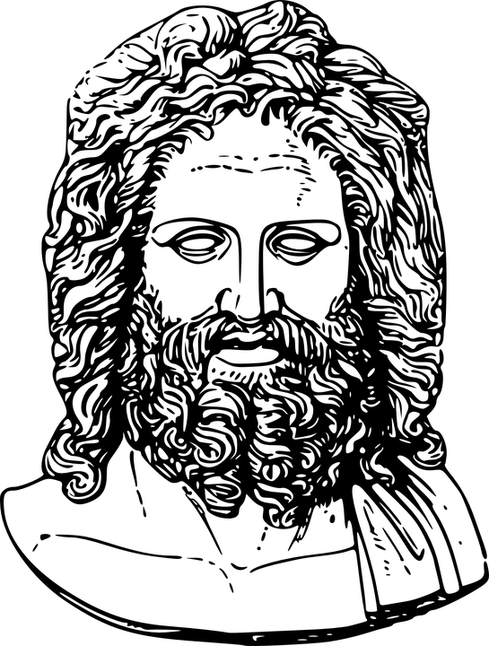
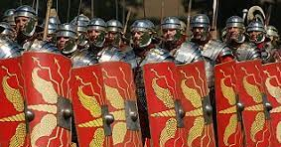
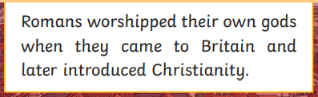
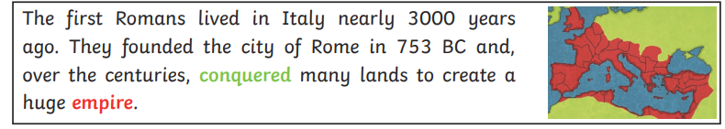
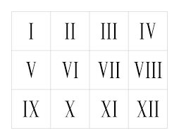
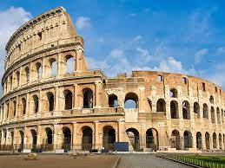
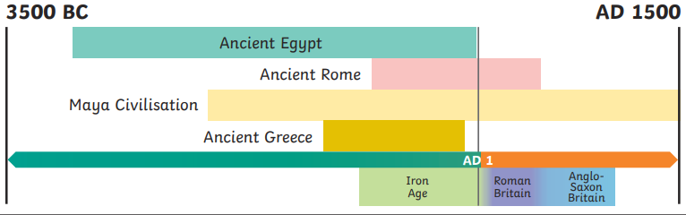
The Romans - Year 4
Discussion Topics and Enquiry Questions
1 | How did the Roman soldiers protect themselves?
2 | Why was the Roman Empire so important?
3 | What were the Roman’s beliefs?
4 | How did the Romans express their Art work?
5 | Why do you think the Roman invasion was so successful?
6 | What was everyday life like in Rome?
Key Vocabulary
Roman Empire | chariot
Gladiator | slave
Boudicca | villa
Colosseum | standard
Mosaic | toga
Scutum (shield) | soldier
Legion | aqueduct
barbarian | amphitheatre
Recommended Reads
Empire’s End – A Roman Story by Leila Rasheed Escape from Pompeii by Christina Balit The sound of Silence by Katrina Goldsaito.

Slide 2




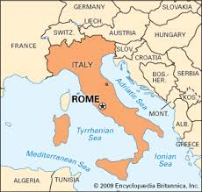
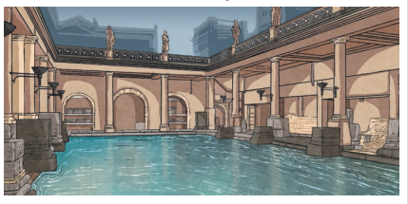
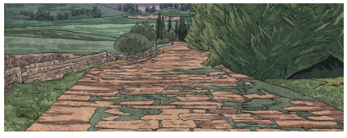
The Romans - Year 4
Sticky Knowledge
Recognise why the Romans became such a powerful empire and understand the impact on Britain. Understand the way the Roman army was organised and why it was effective in battles. Understand the way the Roman society lived and how it still affects the way we live today. Understand that evidence from the past is obtained from artefacts and other evidence left by ancient civilizations. Recognise the influence of the Roman culture in Britain and how it changed the way we lived and traded with other cultures. Recognise that there were other groups of people inhabiting the British Isles and understand the effect the Roman invasion had on those peoples.
Oracy Skills
Social Actively hearing others and responding appropriately. | Cognitive To be able to give supporting evidence e.g. citing a text or previous example or historical event.
Linguistic To use key vocabulary when discussing the Roman’s way of life. | Physical To consider voice projection, body language and posture when presenting facts about the Roman’s.
Sentence Stems
This happened around the same time as... I think the most important reason for [event] was... because.... One factor that contributed to [event] was.... The evidence suggests that.... Because of [cause], the result was [effect]. People at that time might have thought.... This was important because.... For us today, this means... but for them it meant.... In contrast to today, they.... I agree with [name]'s point, and I also think.... I understand [name]'s idea, but I also want to add.... I would like to explain why.... The source supports my thoughts by....

