Slide 1


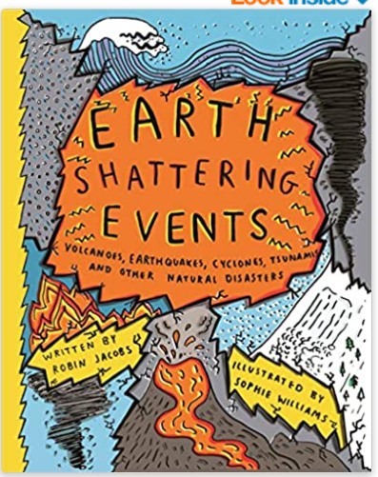




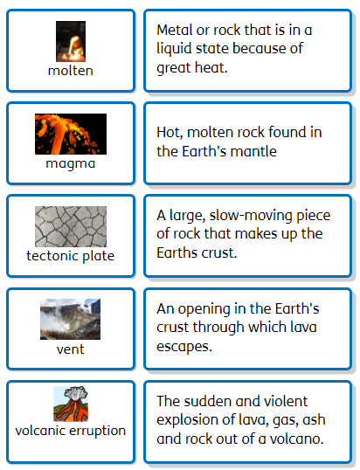
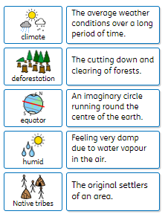
Extreme Earth– Year 3
Recommended Reads
Oracy Skills
Social To have the confidence to have a different opinion to others. To make sure that everyone in the group makes a contribution. | Cognitive To offer opinions which aren’t their own. To be able to reach a shared agreement
Linguistic To use specialist vocabulary and make precise vocabulary choices. | Physical To consider position and posture when addressing an audience.
What is extreme about the Earth?
Sentence Stems
The processes causing this are…. This picture/diagram shows…. This happens because…. I have found……..
Key Vocabulary
Discussion Topics and Enquiry Questions
1 | What is under our feet?
2 | What are volcanoes, earthquakes and tsunamis and how do they affect the earth?
3 | What are keys and how do we use them to read a map?
4 | Why are rainforests important and what is the impact of deforestation?
5 | Can you compare the Amazon to Great Britain?

Slide 2
Core knowledge and skills
Learn about the layers of the Earth and tectonic plates. Understand why Earthquakes and volcanoes happen. Talk about the impact of natural disasters on the physical and human world. Discuss the pros and cons of living near a volcano. Learn about the eruption of Mount Vesuvius and its impact on Pompeii. Comparing the climate in the Amazon with the climate in the UK. Develop our geographical knowledge to include, biomes, equator, lines of longitude and latitude and the Northern and Southern Hemispheres. Comparing the layers of the rainforest. Learning about different sources of renewable energy. The impact of deforestation on the rainforest. How plants and animals have adopted to their habitat in the rainforest. Looking at the role of a key on a map and how different symbols are used. Creating our own maps with symbols and a key. What different plants need to survive and how they reproduce. Look at how water is transported around a plant. How rivers are used and why people settle near them. The positive and negative effects of river use. Learn about Henri Rousseau and do a painting in his style. Investigate how vehicles move on different surfaces. Investigate whether objects are magnetic and how the north and south poles of a magnet work.

