Slide 1

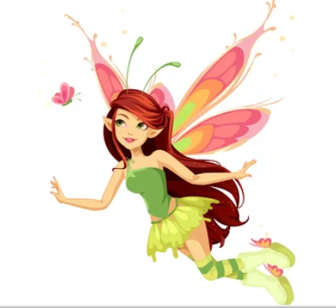


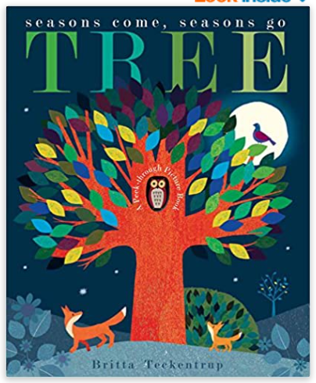
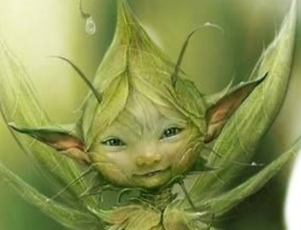
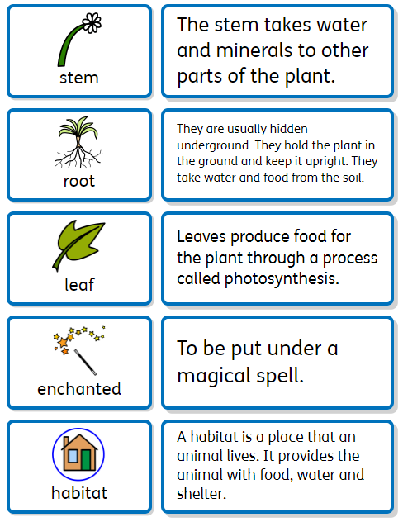
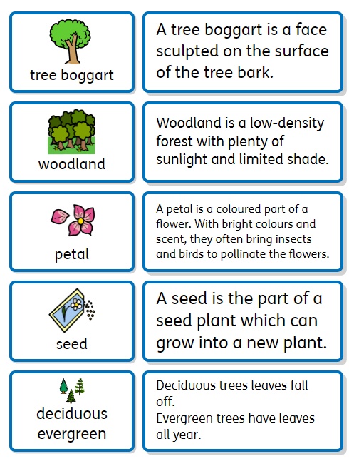




https://www.booksfortopics.com/dinosaurs
Core knowledge and skills
Develop children’s knowledge of British wildlife and woodland habitats. Children will observe and identify plants and animals, understand seasonal changes and appreciate the wonder of the woodland. The children will name the countries in the UK and locate them on a map.
Y1 The Magic of the Woodland.
What might you find in the Woodlands?
Sentence Stems
I agree with… I disagree with… I can see… I know… I wonder… What if…
Recommended Reads
Discussion Topics and Enquiry Questions
1 | What makes trees different?
2 | What homes can you find in the woodland?
3 | What does a habitat provide?
4 | Are trees and flowers the same?
5 | How many countries are in the United Kingdom?
Key Vocabulary
Oracy Skills
Social To take turns in group discussions with their peers To listen to others and be willing to change their mind based on what they have heard. | Cognitive To be able to challenge someone else’s opinion or disagree politely To explain ideas and events in a logical order.
Linguistic To use vocabulary appropriate to the specific topic at hand. To use conjunctions to organise and sequence ideas e.g. firstly, then, finally. | Physical To use the appropriate tone and volume of voice in different situations To use expression when speaking and reading

Slide 2
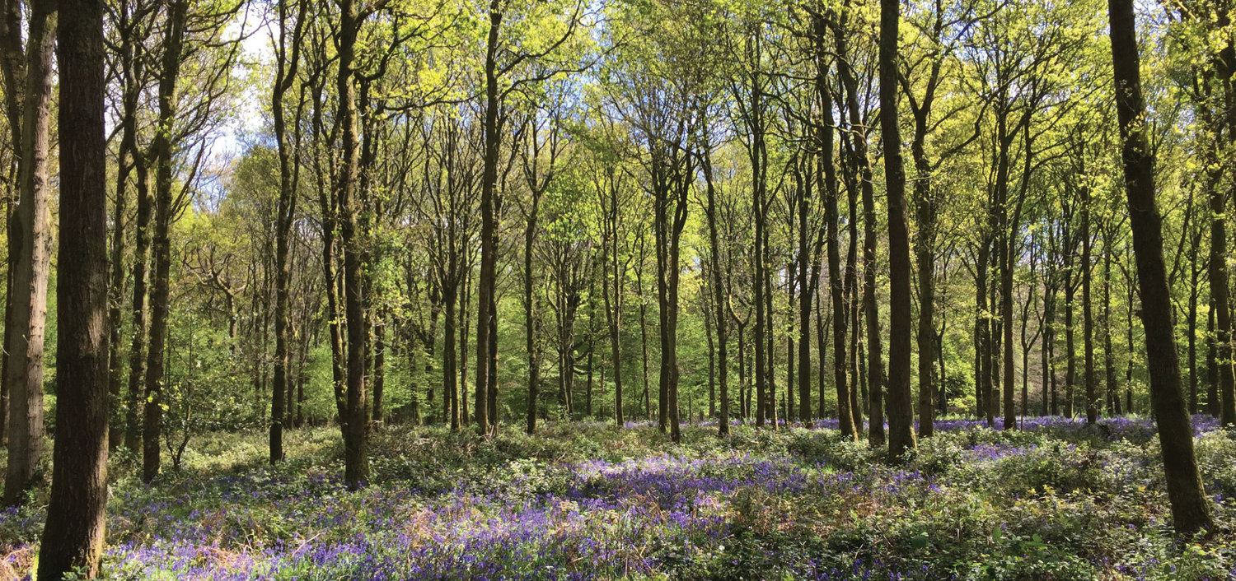
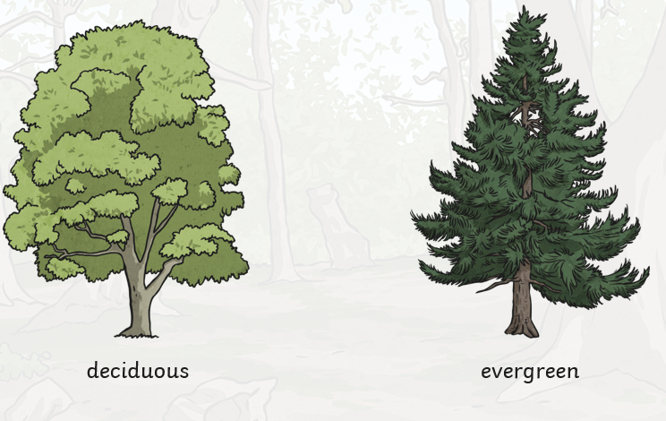
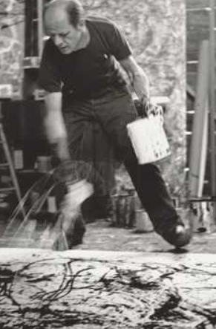
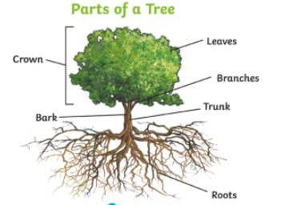
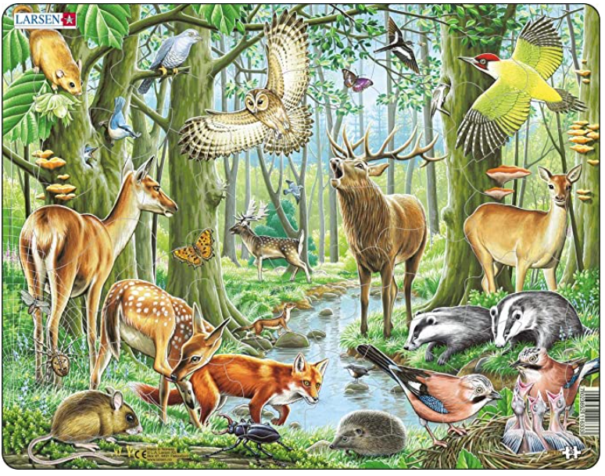
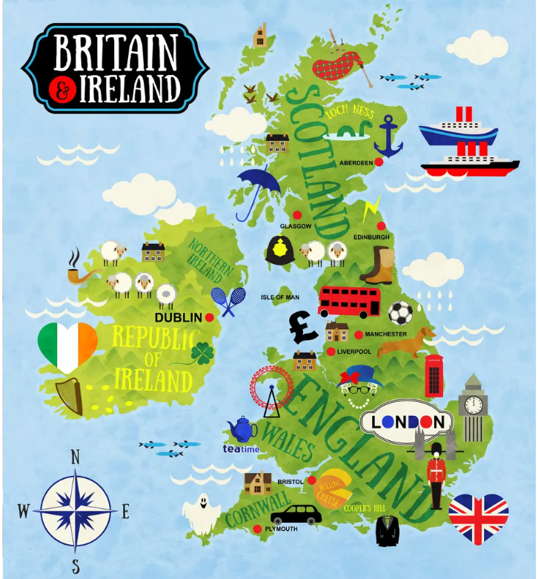
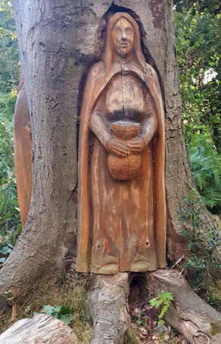
Science
The children will be able to identify deciduous and evergreen trees. An evergreen tree keeps its green leaves all year round. A deciduous tree loses its leaves each year. The children will be able to describe a Woodland habitat. They will identify the different homes inside the woodland e.g Oak trees, dens and setts. They will identify some of the animals that live in the Woodland such as badger, rabbit, fox and squirrel. The children will be able to name and compare the parts of a tree and a flowering plant.
Art
To find out about the modern artist Jackson Pollock. Jackson Pollock was born in America in 1912. He was famous for putting his canvas’ on the floor and he invented ‘drip painting.’ He used different tools to drip, pour and splatter paint onto canvas from above. Jackson’s paintings showed his feelings such as happiness and darkness. Many of his paintings showed sadness as he used lots of dark and gloomy colours.
Geography: Locate countries in the UK
The UK is made up of the island of Great Britain and Northern Ireland. Children to name the capital cities: England- London Wales- Cardiff Scotland- Edinburgh Northern Ireland- Belfast
History
We will find out about the significance of an area in our own locality. We will explore and discuss how our local area changed since children were born. We will explore the local area, looking for evidence / signs / examples of things that have changed since the children were born. We will compare timescales - explore how life changed since their parents / grandparents were young.
Geography: Human and Physical features
To identify human and physical features. Human features are things that are made or built by humans. Physical features are features on the Earth's surface, such as water, lakes, mountains, and desert.

