Slide 1

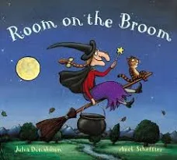
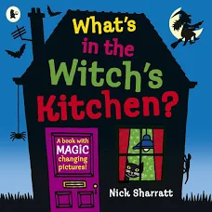

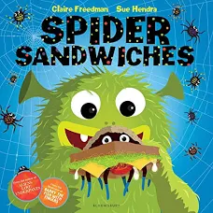



Reception – Autumn 2
Key Texts & Recommended Reads
Sticky Knowledge & Vocabulary
To be able to think carefully about the shapes of things we are drawing. To know what ‘friendly’ means and how to ask to join group play. | To use recently introduced vocabulary in our own stories and role play. To match two words that rhyme and begin to add their own. | To recognise how things around us change according to the season. Use new vocabulary to describe what we see. | To be able to use whole sentences when giving out ideas e.g. in my sandwich I will put… To know how to listen carefully and respond. | To indep. use Tales Toolkit words problem and solution. Understand they are special and what others adore about them (tell someone else) | To confidently give their own idea for a simple story change. Be able to sing our learning song and use ‘work together’ element. | To understand that different families have different traditions. Be able to talk about their own families routines and traditions.
Potion Scaly Passenger Swoop | Disgusting Delicious Escape Cackle | Drifting Orchard Meadow Rustling | Slurp Guzzle Appetite Recipe | Embrace Companion Communicate Adore | Huddle Protect Glide Journey | Celebrate Tradition Festival Respect (Value)
Enquiry Questions
What do I like and dislike? What makes me special? How are we the same/ different? Do all families look the same? How can we be good friends? What does safe/ responsible/respectful look like in our classroom? What helps us learn? What makes a good listener?
Oracy Skills
To be able to turn to a friend when talking and to express their idea audibly. To confidently tell others to join in, stop or ask for a turn in their play. To take a turn speaking when in a small group.

Slide 2
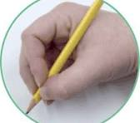
Skills
Personal, Social & Emotional Development
Become familiar with how to meet their needs in the classroom; accessing snack when hungry, remembering to drink their water, getting their school dinner, washing their hands properly. Become content to find comfort with one of the adults, knowing how they can ask for help. To show a sense of themselves by talking about what they have enjoyed in their new classroom or expressing dislikes. Can explain what our Golden Values look like in our classroom and begin to follow them (linked to our Golden Values). Can identify kindness and considerate behaviour of others.
Physical Development
To move confidently, negotiate space and show an awareness of others in the Reception garden and large playground. To develop core strength and begin learning our ‘animal poses’ – meerkat, strong bear, lying lizard and penguin. Continue to develop their small motor skills so that they can use a range of tools competently, safely, and confidently e.g using their own knife and fork, being able to use a paintbrush, can take lids of pens and do up their own zips or velcro shoes. Start to learn how to hold their pens/ pencils correctly using our Kinetic Letters ‘3 Friends Hold’ song.
Communication & Language
Be able to communicate with the adults in the classroom to make their feelings known – begin to use ‘Zones of Regulation’ vocabulary. Ask their friend’s questions to find out more information or keep play going inc. Please can I play too? When you’re finished can I have a turn? Begin to use prompts, visuals and the ‘Body Boundary’ song to express their feelings to friends, help advocate for themselves and sort conflicts. Learn our ‘Mr Potato Head’ listening song and be able to work towards showing these skills during short carpet inputs. Talk about their new classroom/ school and compare it to other places using new learnt vocabulary. Sing up to 8 Nursery Rhymes as part of a small group. Be able to link events in a story to their own experiences.
Other Areas
Be confident to make marks for a purpose in their play, giving consistent descriptions about what the meanings of the marks are. These may include some recognisable letters including ones from their name (they may not be the correct sounds yet). Begin to recognise their name and attempt to copy it. Be able to match objects using the stem sentences ‘??? Is the same as ???, they match because ???’ . Be able to identify things that do or do not belong to a set of objects. Identify circle and triangle and link to the numbers 1 and 3. Start to learn the numbers 1-5 in context including subitising (recognising without counting). To be able to talk about and respect what makes us the same/ different. Recognise that families are all different and we belong to our family, class and school community.

