Slide 1
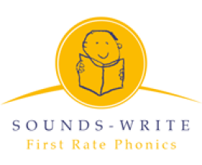
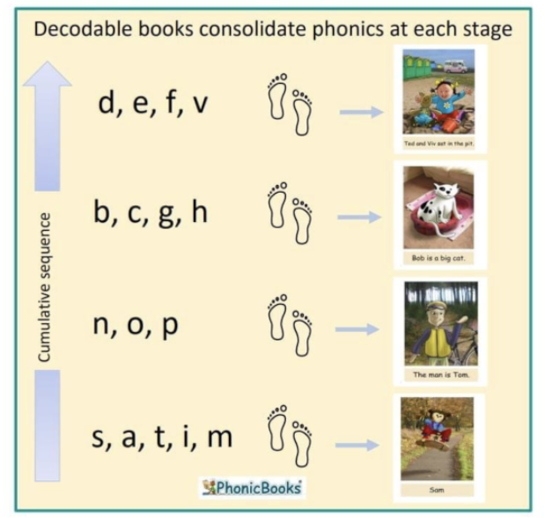
Sounds-Write
At Wildridings, we follow a cumulative, sequenced phonics programme- Sounds-Write.
It teaches the children how to read, write and spell.
Notes:
We have chosen the Sounds-Write programme. Reading and writing taught together. Supports progress for spelling and reading. It starts in Reception and continues through KS1. Spellings are taught through the same approach with KS2 spellings.
Structured, multi-sensory, code-oriented, instructional approach to teaching children to read and spell.
The lessons stay the same. The content changes.
Whole Class approach.

Slide 2
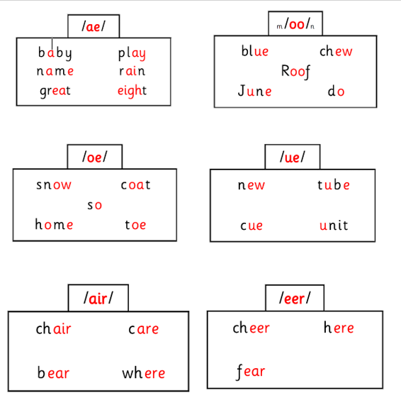

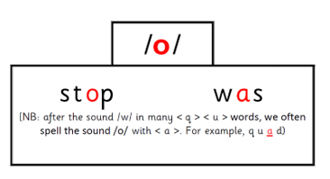
What do we teach?
Same sound, different spelling
Conceptual Knowledge
Letter are symbols (spellings) that represent sounds. A sound may be spelled by 1,2,3 or 4 letters. The same sound can be spelt in more than one way One sound- different spellings rain break gate stay Many spellings can represent more than one sound. One spelling, different sounds head seat break
Skills
1. Blending – the ability to push sounds together to build words. Example /k/ /a/ /t/ - cat 2. Segmenting – the ability to pull apart the individual sounds in words Example pig - /p/ /i/ /g/ 3. Phoneme manipulation- the ability to insert sounds into and delete sounds out of words. This skill is necessary to test out alternative for spellings that represent more than one sound.
Same spelling, different sound
Notes:
Lesson plans are clearly structured and easy to follow within a systematic, synthetic phonics programme. We teach knowledge and skills.
It teaches all key elements of conceptual understanding, factual knowledge, and the three essential skills of blending, segmenting and phoneme manipulation necessary for learning to read and spell and it does so on a daily basis until all children achieve the automaticity that underlies the fluency of every successful reader.
The lesson structure stays the same and the content changes. This helps children to focus on the knowledge and skills they are learning.
We want the children to learn that letters are spellings for sounds, so that when they see the spellings
< m > < a > < t >, they say and hear /m / /a / /t /, 'mat’.
Not using the terms trigraph, digraph
Examples- Sound Swap

Slide 3
The Sounds~Write Code
The sounds write programme is broken down into two codes.
The Initial Code: (Reception) Start with simple, one sound/one spelling, one-syllable, CVC words Then onto one-syllable words using four-, five- and six-sound words of the structure CVCC, CCVC, CCVCC/CCCVCC, Then the most common consonant digraphs ch, sh, th, tch The Extended Code (From Y1 onwards): Remaining common vowel and consonant sound to spelling correspondences are taught until all the common spellings for the forty-four sounds in English have been covered. Pupils are taught how to read and spell polysyllabic words, progressing from two-syllable to five- and six-syllable words.
We also teach polysyllabic words
80% words are polysyllabic in the English language. Examples of polysyllabic words- •Stunt/man •Help/desk •Win/dow
Notes:
Breakdown of the programme. Our phonics scheme refers to the sounds taught as the code. It starts simply and then becomes more complex once the children have grasped the initial understanding.
Books with no words at first.
Sounds on laminated post its.
Children take books that are behind the sounds taught in class, not exposed to new content too soon.
Pure sounds

Slide 4
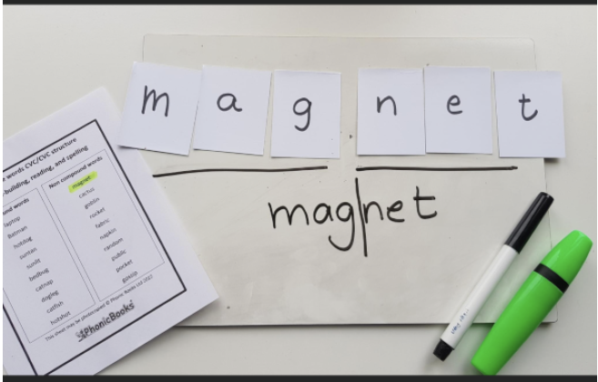
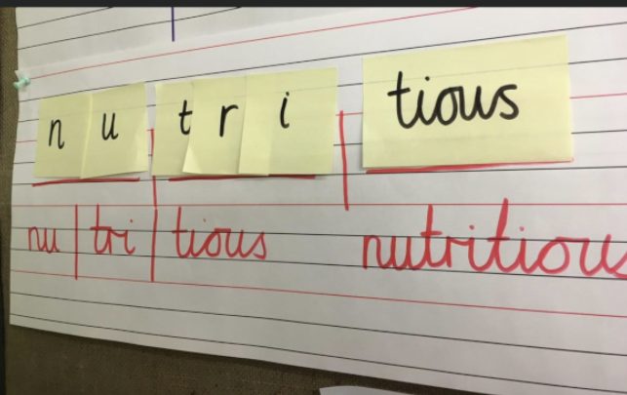
Polysyllabic words
Learning to read and spell polysyllabic words.
Children use the same method of building graphemes within one syllable. They build one syllable at a time. They can use this for both reading and spelling.

Slide 5

TOP TIPS!
Bedtime is not the best time to get a child to read, as decoding can be very tiring. Try after school or first thing in the morning Read in short bursts. Reading is exhausting for beginner readers. Encourage the learner to blend the sounds (say sounds and push them together) throughout the word Be patient - give the child time to work the word out by sounding it out Give your child the opportunity to self-correct. If the child does not know the sound of a grapheme (letter or combination of letters), tell him/her what it is but let the child blend it into the word themselves High-frequency words are common words, some of which have complex spellings. Beginner readers may have difficulty decoding them. To help with these words, point to the graphemes (letters) and say the sounds and, if the child is not ready to read it, or has difficulty blending the sounds together, then say the word for him/her. In time the child will begin to recognise these words. Explain new vocabulary.

