Slide 1
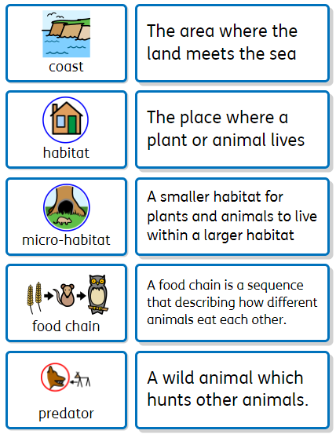
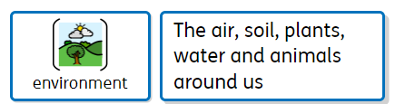


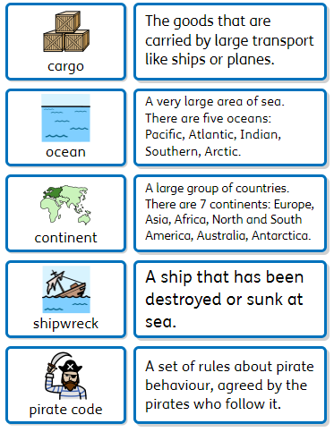



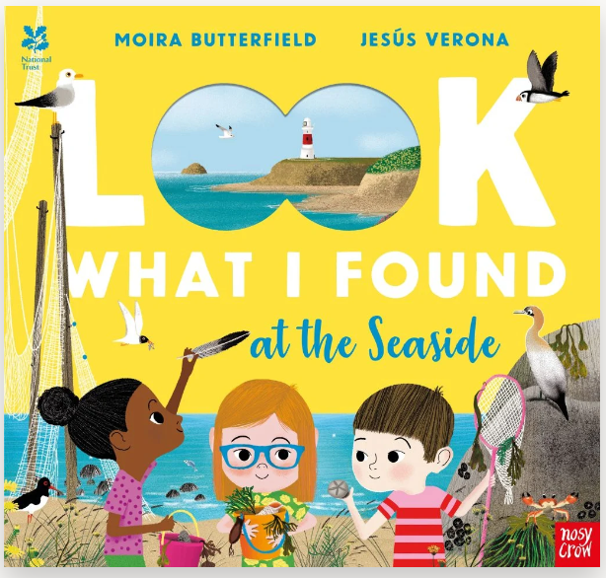
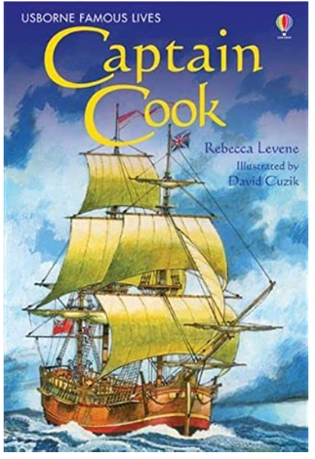


Year 2
Theme: Life at Sea
Key Vocabulary
Oracy Skills
Social To invite others into a discussion. To be confident when I have a different opinion to someone else. | Cognitive To challenge someone else’s opinion politely. To ask questions to find out more about a subject.
Linguistic To use technical and specific To use sentence stems to explain what we think. | Physical To use gestures. To project our voices to larger audiences (nativity)
Discussion Topics and Enquiry Questions
1 | What are the features of a beach?
2 | Why do some animals live in shells?
3 | How has visiting the seaside chanted over time?
4 | How do we know if something is alive?
5 | Who is James Cook and why is he famous?
6 | Can you name the 5 oceans and the 7 continents?
Recommended Reads
Sentence Stems
I agree with… I disagree with… I would like to challenge… It happens because… I wonder…

Slide 2
Year 2
Theme: Life at Sea
Sticky Knowledge
Children will: Understand objects can be living, dead or never been alive. Identify physical and human features of a coast Construct and understand a basic food chain. Understand the difference between a habitat and a microhabitat Identify features of different animal groups Explain how seaside's have changed overtime Name the 7 continents and locate them on the map. Name the and locate the worlds oceans Identify materials that float and sink. Evaluate their ideas against design criteria. Explain and understand the life of James Cook. Know and create art in the style of Monet. Use pattern and texture to create a still life drawing. Materials can be changed by squashing, bending, twisting and stretching. Understand the basic needs for survival Use directional language including North, South, East and West
Prior Knowledge
Identify and name a variety of common animals Identify animals that are omnivores, carnivores and herbivores Understand the difference between old and new Understand the difference between a physical and human feature Cutting and joining. Understand that individuals have made changes in the past.
Key Skills
The skills we will use in this topic are: Identifying features Observing changes Exploring the past Using mixed media for art Cutting and joining materials Designing and making. Identifying and comparing. Using maps. Evaluating our designs. Asking and answering simple questions

