Slide 1
Phonics at Wildridings We follow a cumulative, sequenced phonics programme.
Why do we focus on phonics?
Decoding is essential for children to become fluent, accurate readers. Children will build fluency with accurate decoding. Enables pupils to become automatic and accurate readers.

Slide 2
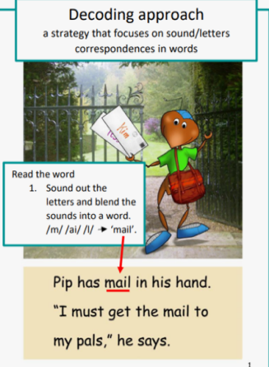
Why Sounds-Write?
It is a reading programme based on the sounds in speech, moving from sounds to the written word.
Our Focus

Slide 3
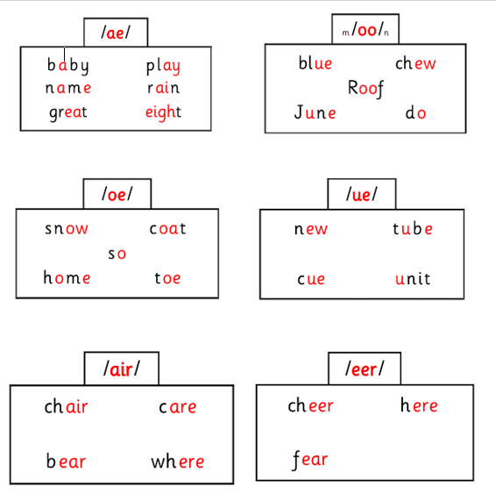
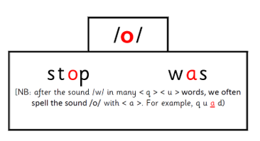
What do we teach?
Same sound, different spelling
Conceptual Knowledge
Letter are symbols (spellings) that represent sounds. A sound may be spelled by 1,2,3 or 4 letters. The same sound can be spelled in more than one way One sound- different spellings rain break gate stay Many spellings can represent more than one sound. One spelling different sounds head seat break
Skills
1.Blending – the ability to push sounds together to build words. Example /k/ /a/ /t/ - cat 2. Segmenting – the ability to pull apart the individual sounds in words Example pig - /p/ /i/ /g/ 3. Phoneme manipulation- the ability to insert sounds into and delete sounds out of words. This skill is necessary to test out alternative for spellings that represent more than one sound.
Same spelling, different sound

Slide 4
The Sounds~Write Code
The sounds write programme is broken down into two codes.
The Initial Code: Start with simple, one sound/one spelling, one-syllable, CVC words Then onto one-syllable words using four-, five- and six-sound words of the structure CVCC, CCVC, CCVCC/CCCVCC, Then the most common consonant digraphs ch, sh, th, tch The Extended Code (From Y1 onwards): Remaining common vowel and consonant sound to spelling correspondences are taught until all the common spellings for the forty-four sounds in English have been covered. Pupils are taught how to read and spell polysyllabic words, progressing from two-syllable to five- and six-syllable words.
We also teach polysyllabic words
80% words are polysyllabic in the English language. Examples of polysyllabic words- •Stunt/man •Help/desk •Win/dow

Slide 5
TOP TIPS!
Bedtime is not the best time to get a child to read, as decoding can be very tiring. Try after school or first thing in the morning Read in short bursts. Reading is exhausting for beginner readers. Encourage the learner to blend the sounds (say sounds and push them together) throughout the word Be patient - give the child time to work the word out by sounding it out Give your child the opportunity to self-correct. If the child does not know the sound of a grapheme (letter or combination of letters), tell him/her what it is but let the child blend it into the word himself/herself. High-frequency words are common words, some of which have complex spellings. Beginner readers may have difficulty decoding them. To help with these words, point to the graphemes (letters) and say the sounds and, if the child is not ready to read it, or has difficulty blending the sounds together, then say the word for him/her. In time the child will begin to recognise these words. Explain new vocabulary.

Slide 6
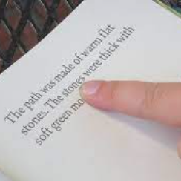
Parental support
Pure sounds
We ensure the children are using pure sounds when they are blending and segmenting. We don’t refer to the sounds by their letter names. Here is a helpful clip:
https://www.youtube.com/watch?v=IwJx1NSineE
Parent Course for Reception parents
‘Say the sounds and read the word’.
IMPORTANT
Children use the gestures/ pointing with their finger to each sound to say the sounds e.g. c-a-t Then they run their finger under the word to blend it, read the word e.g. cat

