Slide 1
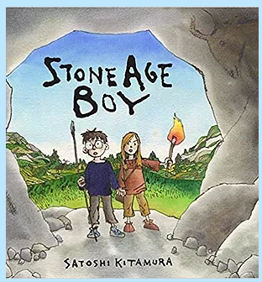
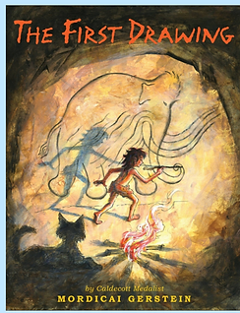
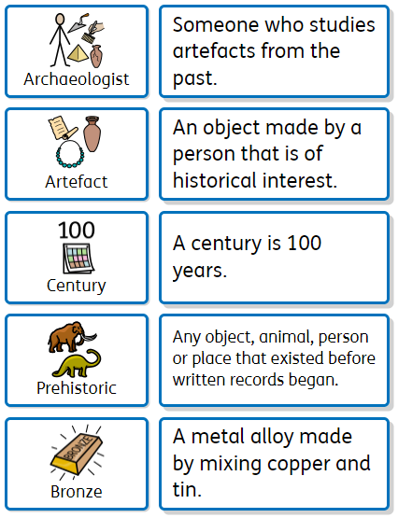
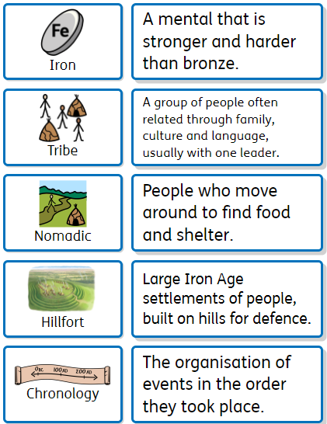
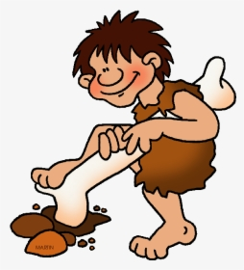
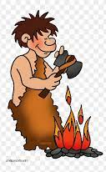
Stone Age to Iron Age
– Year 3
Recommended Reads
Oracy Skills
Social To have the confidence to have a different opinion to others. To make sure that everyone in the group makes a contribution. | Cognitive To offer opinions which aren’t their own. To be able to reach a shared agreement
Linguistic To use specialist vocabulary and make precise vocabulary choices. | Physical To consider position and posture when addressing an audience.
How did the discovery of Bronze and Iron impact life in Britain?
Key Vocabulary
Sentence Stems
This is evidence that….. This source tells us that…… This happened because…. I have noticed that……..

Slide 2
Core knowledge and skills
How life changed from the Stone Age to the Iron Age. What is meant by chronological order. Key aspects of everyday life in the Stone, Bronze and Iron Ages and how they were similar and different. How the introduction of Bronze and Iron impacted society and why. How we use and interpret sources to find out about the past. How the discoveries of the Amesbury Archer and Cheddar Man inform us about life in the past. What we can learn from the discovery of Skara Brae. Who the Beaker folk were and what impact they had on life in Britain. Recognising different light sources and investigating how shadows are formed and changed. How we can stay safe in the sun. Reflective materials and how they are used.
Discussion Topics and Enquiry Questions
1 | What is chronology?
2 | What was everyday life like in the Stone, Bronze and Iron Ages?
3 | How did life change with the discovery of new metals?
4 | How do prehistoric sources tell us about the past?
5 | What objects reflect light and how are shadows formed?

