Slide 1
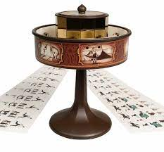
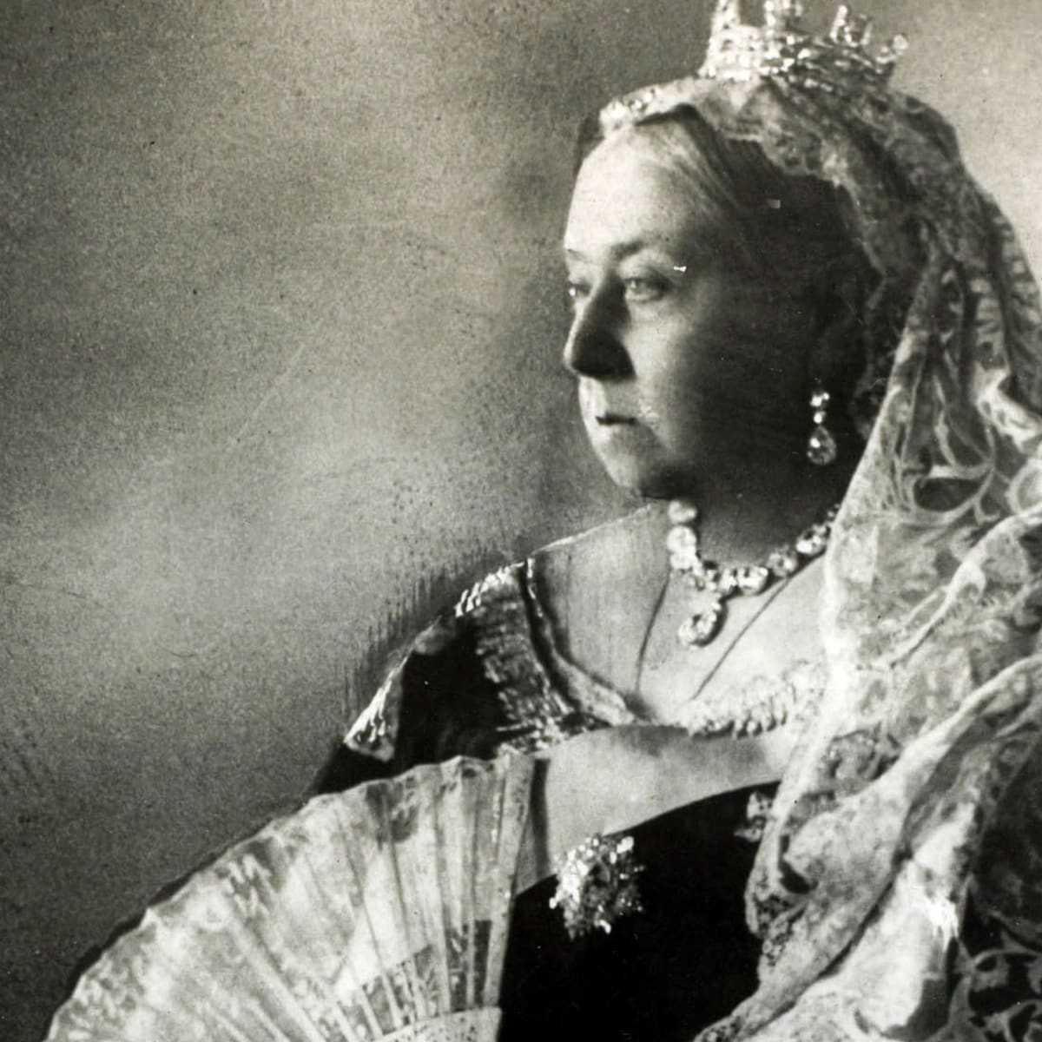
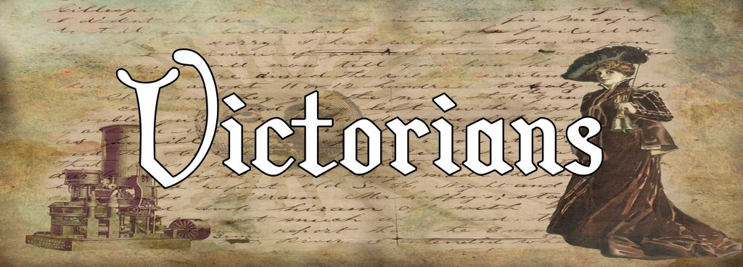
Victorians and the Industrial Revolution - Year 6
Discussion Topics and Enquiry Questions
1 | What did the Victorians do for us?
2 | What was life like for poor children in Victorian England?
3 | How did life differ for the rich and a poor of Victorian England?
4 | What was ‘The Great Exhibition’ and why was it such a significant event?
5 | How can I create an electrical circuit to solve a problem?
Sentence Stems
I agree with… because… I disagree with… because… I would like to challenge the view… Adding onto …’s point… In my opinion… I know this because…
Recommended Reads
Oliver Twist – Charles Dickens A Christmas Carol – Charles Dickens Gaslight – Eloise Williams Cogheart – Peter Bunzl Street Child – Berlie Doherty Son of the Circus – E.L. Norry Vile Victorians – Horrible Histories Twelve Minutes to Midnight – Christopher Edge
Oracy Skills
Social To be able to present information fluently and confidently | Cognitive To construct a detailed argument and respond to more complex questioning
Linguistic To respond using sophisticated sentence stem and give evidence support their suggestions | Physical To respond positively to others who may disagree with our opinions
Key Vocabulary
Industrial revolution | Workhouse
Monarchy | Descendant
Economic | Poverty (Impoverished)
Prime minister | Punishment
Affluence | Slum
Compulsory | Vaccination
Circuit | Components
Parallel (Circuit) | Simple (circuit)
Series | Symbol

Slide 2
Victorians and the Industrial Revolution - Year 6
Core knowledge and skills
During this topic, we want the children to immerse themselves into life in the Victorian era, especially focusing on the role children played during this time and on the contrast between the impoverished and the rich. We will draw and make connections and contrasts with our current period of history as well as others. We will pay close attention to the impact the Victorian era had with inventions, the expansion of technology and transport and how these have impacted and influenced our lives. The children will develop an ability to analyse multiple sources and deduce information about Queen Victoria and her reign. In addition, by the end of this unit the children will create pop-up puppets after looking at toys children would have had available in that time period. Alongside the history of the Victorian period, children will create a stronger understanding of how electricity runs in a circuit and how to build upon and vary this. They will learn to recognise how to accurately note circuit diagrams, as well as recognise series and parallel circuits. They will be able to identify the differences between electrical conductors and insulators. By the end of this unit, the children will be able to use their knowledge to design and create Christmas decorations using electrical components.

