Slide 1
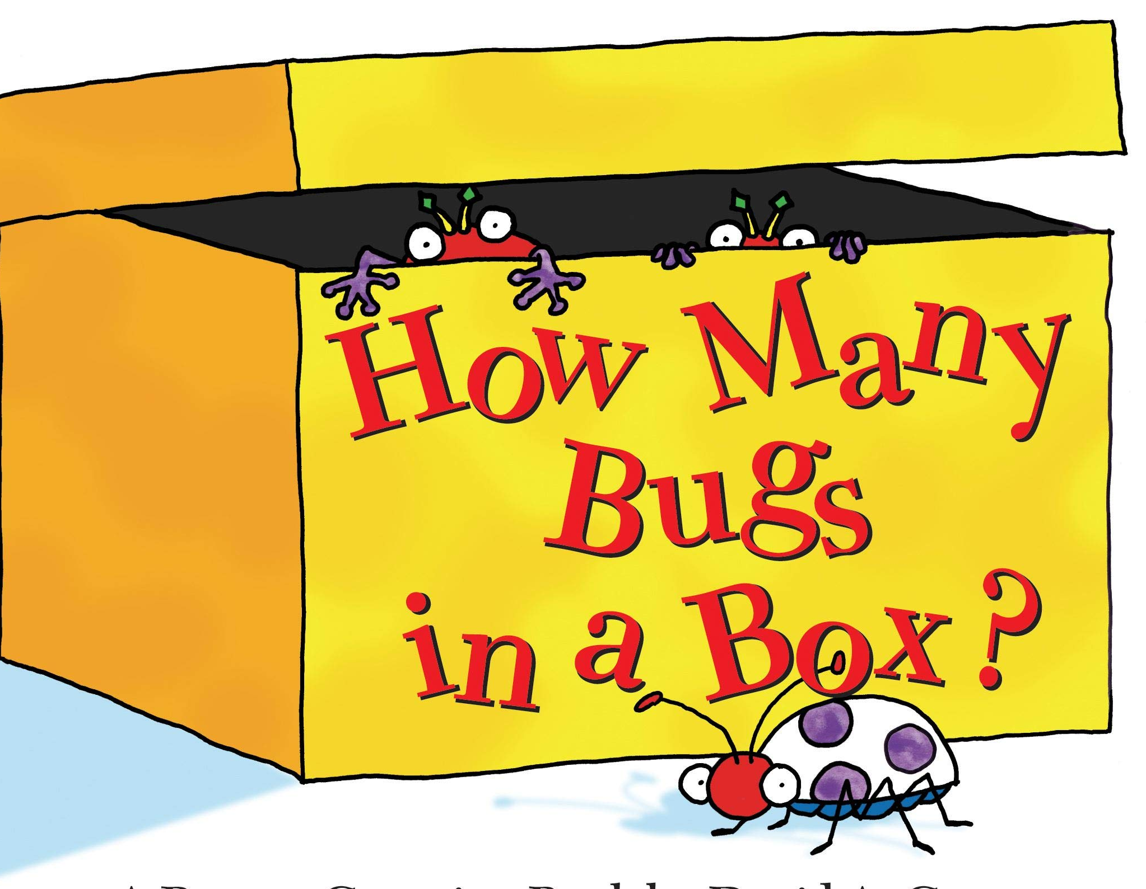
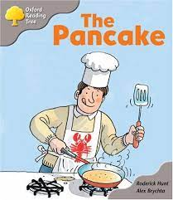
Nursery Knowledge Organiser
Key Texts & Recommended Reads
Core Knowledge & Vocabulary
Making new friendships. Enjoying sharing our experiences of the holidays with each other. | Talk about changes they notice around them. Know the life cycle of plants and animals. | To think about the people we love. We can make pictures for our family. | To find out information on farm animals. To learn correct vocabulary for farm animals. | To learn about the rhyming parts of traditional stories. To learn a new cooking method. | We can make changes to materials (cooking). Reading the numbers for ingredients.
Building relationships. | Season Winter Hibernation Melting | Family Love Emotions | Farm Farm sounds Farm animal features. | Rhyming words Porridge Microwave Likes/dislikes food | Ingredients Batter Numbers Changes
Enquiry Questions
What did you do over the holidays? What natural changes can you see on your way to Nursery? Do you have a special talent? How can you show us? Who do you love in your family? Why did Goldilocks go into the Bear’s house? Can you find out why we have pancakes?
Oracy Skills
To make eye contact with the person we are talking to. To listen to the person who is talking to us. To say, “I can see because..”

Slide 2
Skills
Personal, Social & Emotional Development
Welcoming our new children to Nursery and supporting them to settle in and make friends. In our interactions with our teachers and friends, we will continue to develop how to be kind and caring towards each other. We will learn how washing our hands will keep ourselves safe from germs and getting poorly. To work together in groups for our cookery activities.
Physical Development
We will continue to develop our large motor skills outside in the garden and using the Trim Trail. We will learn how to take safe ‘risks’ when we are using the equipment in the garden. Walking to Bill Hill to look at changes in the season.
Communication & Language
To continue to learn our four nursery rhymes, supporting our language development. To enjoy sharing familiar books and recalling what happens in the stories. In small groups, describing what we have in our ‘chatterboxes,’ increasing our range of words. Be able to ask each other questions to find out what their friends need or want to play with.
Other Areas
Keep developing painting skills to be able to have more choices in our paintings. Using resources in the art area to develop our imaginative and problem solving skills. Becoming more aware of hearing initial sounds in our names. To be more confident in recognising our name label when we have our snack. During our play, to describe the shapes we can see as we build with the resources.

