Slide 1
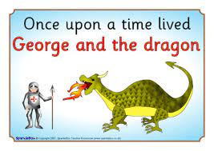
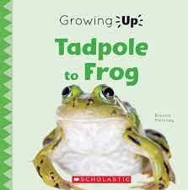
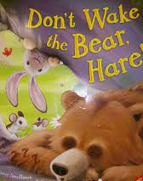
Nursery Knowledge Organiser
Key Texts & Recommended Reads
Core Knowledge & Vocabulary
To learn about a tradition of a saint. What a real knight looks like. Where knights lived and still live today. | Life cycle of a frog Pond life | Special day for King Charles III. To make and send a card to King Charles and Queen Camilla. Plan a Coronation Tea Party. | To explore being an artist. To learn about a life cycle of a plant. To find out how we can recycle everyday projects. | To discover what happens in spring. Planting seeds/plants Local walk environment May Day. | To learn why we need a rainbow diet to stay healthy. Learning how to take care of our body through good hygiene.
St George Dragon Windsor castle | Frog spawn Tadpole Frog | Coronation London Procession | Painting. Planting seeds. Life cycle of a plant. | Spring time Dancing May pole | Fruit Vegetables Plant
Enquiry Questions
Do you think dragons are real? How can you tell what the signs of spring look like/feel /smell or hear? What does your street look like where you live? What can you learn about tadpoles?
Oracy Skills
To make eye contact with the person we are talking to. To listen to the person who is talking to us. To have a conversation in pairs. To say, “I can see because..”

Slide 2
Skills
Personal, Social & Emotional Development
In our interactions with our teachers and friends, we will embed the skills we have learnt in being kind and caring towards each other. In small group discussions to think about how eating healthy foods keep our bodies well. To work together in groups to plant flower and vegetable seeds in our garden and take care of them as they grow.
Physical Development
We will continue to develop our large motor skills outside in the garden and using the Trim Trail. We will learn how to take safe ‘risks’ when we are using the equipment in the garden. Walking trips in our local area and to Mill Pond, using our gross motor skills and senses to keep us safe. Continuing to offer opportunities, such as play-dough, painting and manipulating small objects to strengthen our fine motor skils.
Communication & Language
To continue to learn and recall our eight nursery rhymes, supporting our language development. To enjoy sharing familiar books and recalling what happens in the stories. To enjoy listening to poems and thinking about what the words and their meaning. In small groups, describing what we have in our ‘chatterboxes,’ increasing our range of words. Be able to ask each other questions to find out what their friends need or want to play with.
Other Areas
Keep developing painting skills to be able to have more choices in our paintings. Using resources in the art area to develop our imaginative and problem solving skills. Becoming more aware of hearing initial sounds in our names. To begin to hear and say which words start with the same letter sound. During our play, to describe the shapes we can see as we build with the resources. A trip to Mill Pond, to see evidence of other life cycles (tadpoles in nursery), such as ducks and swans.

