Slide 1
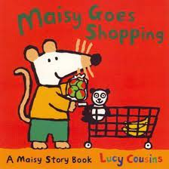
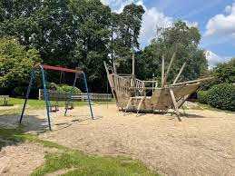
Nursery Knowledge Organiser
Key Texts & Recommended Reads
Core Knowledge & Vocabulary
To follow the process of baking biscuits from buying the ingredients to cooking them. | To plan a party for daddy/male relative. To make a card for daddy/male relative. Plan a Tea Party. | To find out how we know words rhyme. To sing songs with rhyming words. To listen to poems which rhyme. | To embed the knowledge learnt from last week on rhyming words. To say words that rhyme by ourselves. | To link back to previous planning of trips. Plan a trip to Mill Park to use their physical skills on larger equipment. | For the children to think of activities for their Sports Day. To find out how different types of sports keep our bodies healthy.
Shopping Money Ingredients | Daddy/uncle/granddad. Special. | Rhyme. Recognise rhyme. | Produce rhyming words. | Climbing. Balancing. Heart. | Being creative. Exercise. Energy.
Enquiry Questions.
What do you buy when you go shopping? Why is your daddy/male relative special? Can you hear which words rhyme in a rhyming story? Why do we need to stay healthy? What exercise do you like and why?
Oracy Skills
To make eye contact with the person we are talking to. To listen to the person who is talking to us. To have a conversation in pairs. To say, “I can see because..” To say, “I agree/not agree..” To say, “I think/do not think..”

Slide 2
Skills
Personal, Social & Emotional Development
In our interactions with our teachers and friends, we will embed the skills we have learnt in being kind and caring towards each other. In small group discussions to think about exercise and why it is important for our bodies and well-being. To work together to make sure out plants are cared for and grow successfully to produce tomatoes, strawberries and runner beans.
Physical Development
We will move confidently on the large equipment travelling in different ways. We will embed how to take safe ‘risks’ when we are using the equipment in the garden. Walking trips in our local area and to Mill Pond, using our gross motor skills and senses to keep us safe. Continuing to offer opportunities, such as play-dough, painting and manipulating small objects to strengthen our fine motor skils.
Communication & Language
To continue to learn and recall our eight nursery rhymes, supporting our language development. To enjoy sharing traditional stories and think about the content of the story. To enjoy listening to poems and thinking about what the words and their meaning. In small groups, describing what we have in our ‘chatterboxes,’ increasing our range of words. Be able to ask each other questions to find out what their friends need or want to play with.
Other Areas
In our imaginative play to listen, respond and comment to enhance our role-play. Becoming more aware of hearing rhyming words and saying why the words rhyme. To begin to hear and say which words start with the same letter sound. To be confident in saying patterns of numbers we see in our environment. A trip to Mill Park, to put into practise their physical skills they have learnt over the year.

