Slide 1
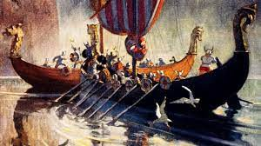
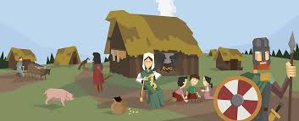
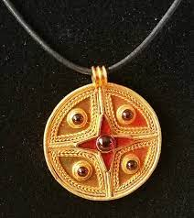
Anglo-Saxons and Vikings - Year 4
Core knowledge and skills
History : learning about the Anglo-Saxons and Vikings about their importance, when they were relevant in History and how they lived and travelled. To understand their legacy and influence in Britain. Art/D&T: making a small Anglo-Saxon charm using historical sources and carving letters from the Runic Alphabet. Learn weaving techniques and make a small textile sample. Geography: reading and labelling a map, looking at routes of the Vikings and making a key of Viking settlements and homelands.
Discussion Topics and Enquiry Questions
1 | Who were the Anglo-Saxons and why are they remembered in History?
2 | How did Anglo-Saxons live their daily life?
3 | Where did the Saxons settle in Britain and how is this similar and different to where the Romans settled?
4 | Why do you think places are still named after St Bede?
5 | How did the Vikings live their daily life and where did they invade?
Sentence Stems
I agree with… because… I disagree with… because… I would like to challenge the view… Adding onto …’s point… In my opinion… I know this because…
Key Vocabulary
St Bede | Wessex
Runic Alphabet | oarsmen
Border | Briton
carving | King Arthur
Alfred the Great | Knights of the Round Table
pagan | Mercia
conquer | The Hall
scramasax | Viking longhouses
Thegn | tunics
Oracy Skills
Social Working with others. | Cognitive To ask probing questions
Linguistic To use specialist language to describe their own and others’ talk | Physical To consider movement when addressing an audience.
Recommended Reads
Beowulf by Michael Morpurgo and Michael Foreman King Arthur and the Knights of the Round Table by Marcia Williams Anglo-Saxon body by Tony Bradman

Slide 2
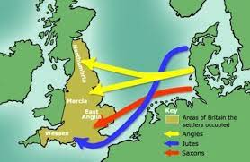
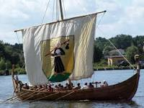
The Anglo Saxons and Vikings - Year 4
Sticky Knowledge
Recognise why the Anglo Saxons and the Vikings invaded the UK and how they came to this shores. Understand the chronology involved in these invasions. Understand the effect of these invasions in Britain and how they affected the way the land and kingdoms were organised in the Dark Ages. Understand that evidence from the past is obtained from artefacts and other evidence left by ancient civilizations. Recognise the influence of the different cultures in Britain and how it changed the way we organised life in the British Isles. Recognise that there were other groups of people inhabiting the British Isles and the understand the effect the invasion had on those peoples. Understand how they influenced life culturally and learn about the legacy that is still present in our lives today.
Oracy Skills
Social To consider the impact of their words on others when giving feedback | Cognitive To be able to give supporting evidence e.g. citing a text or previous example or historical event.
Linguistic To carefully consider words and phrases they use to express their ideas and how this supports the | Physical To consider movement when addressing an audience
Sentence Stems
I agree with… because… I disagree with… because… I would like to challenge the view… Adding onto …’s point… In my opinion… I know this because…

