Slide 1
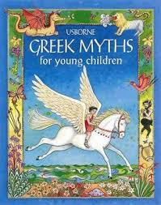
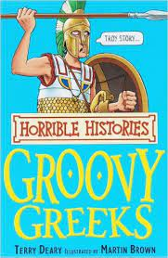
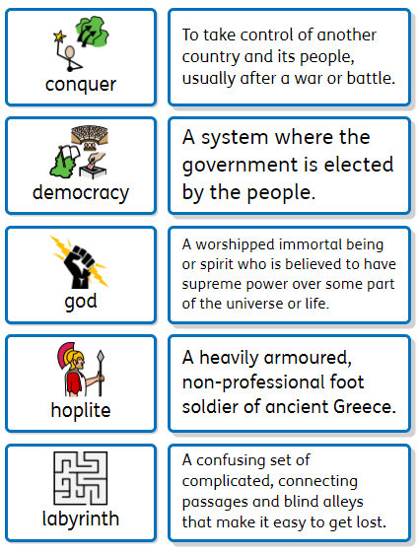
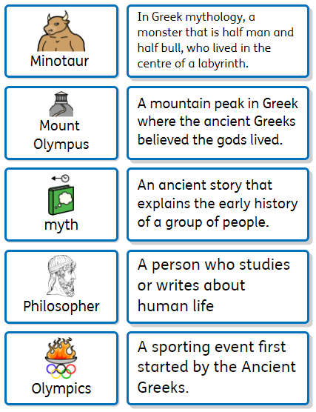
Groovy Greeks
Year 3
Recommended Reads
Oracy Skills
Social To speak with confidence in front of an audience. To make sure that everyone in the group makes a contribution. | Cognitive To make what they are saying more exciting for the audience. To be able to summarise a discussion.
Linguistic To use specialist vocabulary and make precise vocabulary choices. | Physical To deliberately vary the tone of voice in order to convey meaning.
Who were the Ancient Greeks?
Key Vocabulary
Discussion Topics and Enquiry Questions
1 | Who were the Greek Gods?
2 | How can we find out about and order events from the past?
3 | What was life like in Ancient Greece?
4 | What was it like to be a Greek soldier?
5 | What is Athens like today compered to where we live?
Sentence Stems
I have learnt that… The evidence suggests…. In comparison….. In my opinion……

Slide 2
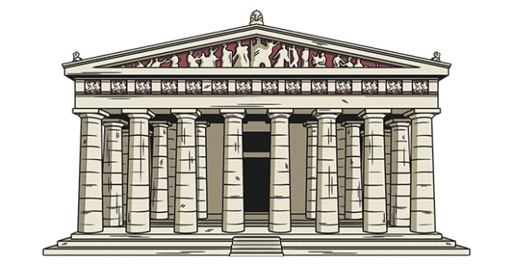
Core knowledge and skills
Understand what life was like in an Ancient culture. Ordering events in chronological order. Use different sources to find out information and evaluate it. Learn about Greek mythology. Compare a European city to where we live. Learn about Greek Gods and Goddesses. Learn about Greek art and pottery and design own Greek pot. Learn about a key figure in Ancient Greek culture and the impact their had. Understand the importance of the Olympics and plan their own event. Look at key events e.g. Battles and their significance. To know how fossils are formed. To investigate different soils and what makes a good soil for growing plants. Be able to identify different light sources. Talk about how to stay safe in the sun. Investigate how shadows are formed and find patterns in how they change.

