Slide 1
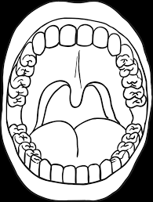
The Human Body - Year 4
How does the human body digest food?
Discussion Topics and Enquiry Questions
1 | How many types of different teeth are there?
2 | Why do we have saliva and how is it used when we are eating?
3 | How does the human digestive system work?
4 | Which drinks could lead to more tooth decay?
5 | How does an animal digestive compare to a human’s digestive system?
Core knowledge and skills
Science: describe the simple functions of the basic parts of the digestive system in humans and identify different types of teeth in humans and their simple functions. PSHE/RSHE: risks associated with unhealthy eating (tooth decay).
Key Vocabulary
Abdomen | Enamel
Amilase | Enzyme
Bile | Faeces
Bolus | Incisor
Bowel | Intestine
Canine | Mandible
Colon | Maxilla
Decay | Molar
Dentine | Oesophagus
Digestion | Saliva
Oracy Skills
Social To consider the impact of their words on others when giving feedback. | Cognitive To be able to give supporting evidence e.g. citing a text or previous example or historical event.
Linguistic To carefully consider words and phrases they use to express their ideas. | Physical To consider movement when addressing an audience.
Recommended Reads
Microbiology: It’s a small world by Dan Green Disgusting Digestion by Nick Arnold The Lucky Escape (Human body detectives) by Dr Heather Manley

Slide 2
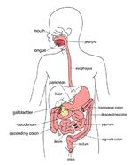
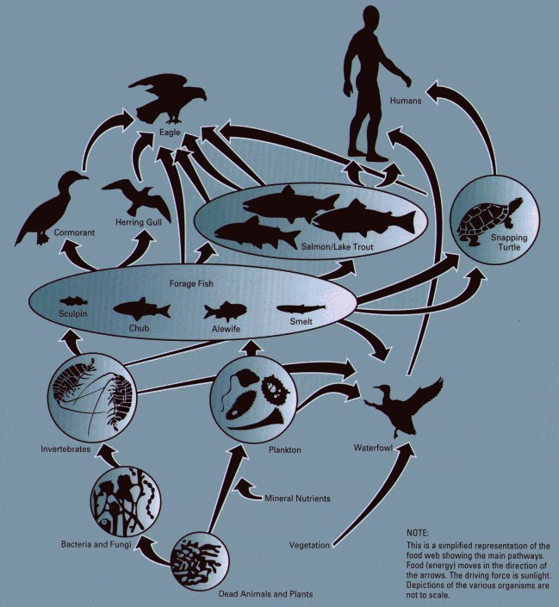
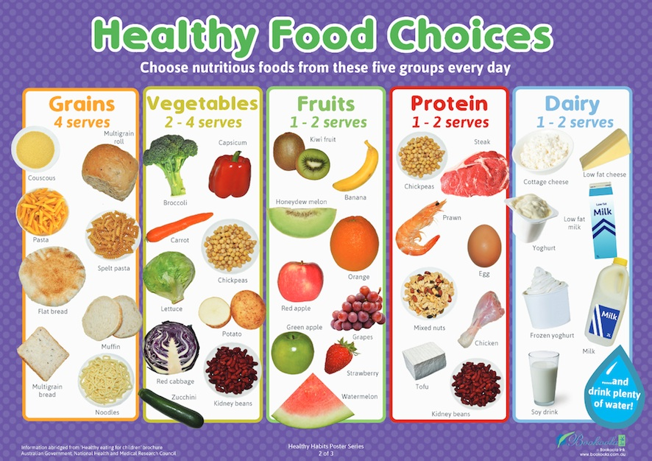
The Human Body - Year 4
Sticky Knowledge
Recognise teeth have different functions depending on their shape and position in the human mouth. Compare human and other animal’s teeth. Recognise that some foods can damage our teeth. Know the basic facts of mouth hygiene. Understand that digestion begins in the mouth and that saliva has got an important role in this process. Recognise that there are many organs in the human body involved in the digestion of food and they all have specific functions in this process. Understand that our food choices can affect the digestion process and consequently our general health. Recognise the gut is a very important organ in our body and has a varied flora to keep us healthy. Recognise that humans are part of a food chain. Be able to understand a human food chain compares with other food chains in nature. Be able to compare and point out the similarities and differences between the human digestive system to other animal’s digestive systems.
Sentence Stems
I agree with… because… I disagree with… because… I would like to challenge the view… Adding onto …’s point… In my opinion… I know this because…

