Slide 1
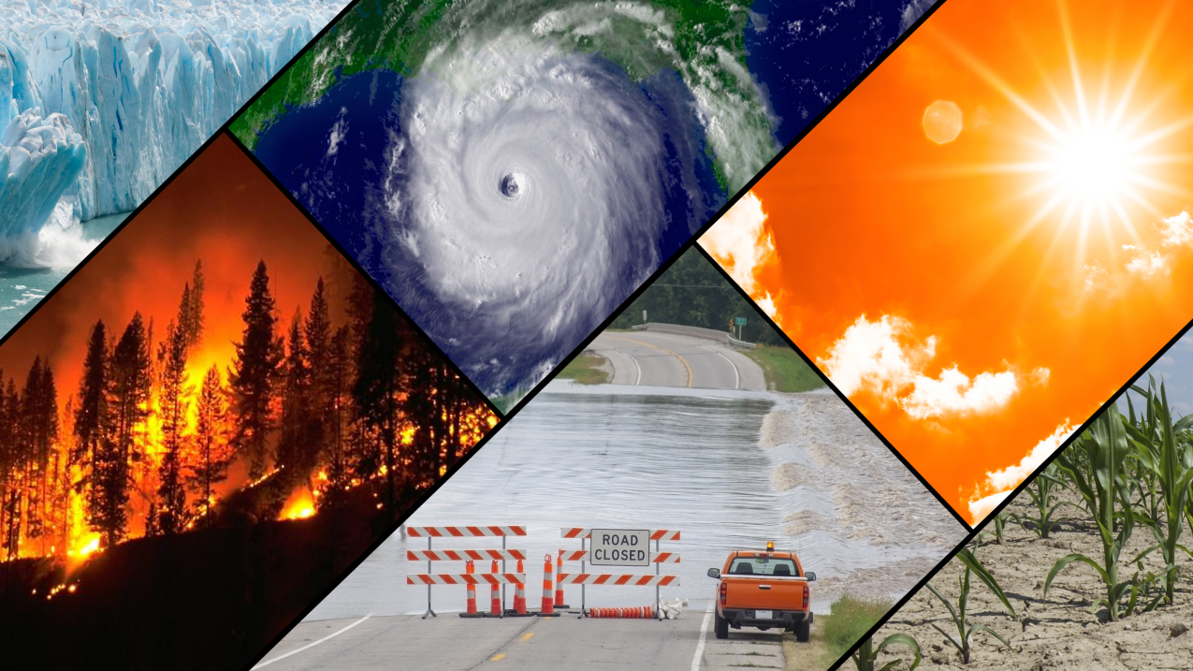
Adapting to climate change – Year 6 - ‘What is happening to our planet and how will the animals cope?’
Discussion Topics and Enquiry Questions
1 | Why is a polar bear white? How is it suited to its environment?
2 | How do we know dinosaurs existed? What does the evidence tell us?
3 | Why do animals live in their environments?
4 | How do animals stay alive in their habitats? How are they adapted to their environment?
5 | Why do I have brown hair when my mum has blonde?
6 | Why do different countries experience different weathers?
Core knowledge and skills
Geography: Identify key geographical lines on a world map. Understand that with invisible lines we can locate countries around the world with ease. Identify weather types and climates. Link climates with zones around the world. Identify what affects climate in order to associate with climate change and impact on our current world. Look at weather measuring tools and compare and evaluate effectiveness. Science: To understand that animals are adapted to their habitats as a means of survival. To understand specific characteristics of animals and that animals are classified into groups (mammals, amphibians etc.). To understand that offspring carry genes from their parents and natural selection plays a part in evolution of species. To identify food chains and feed webs. What happens if part of a food web collapses or the numbers reduce? What happens if there is a population explosion in part of the food web?
Key Vocabulary
Polar regions | Arctic | Climate | Ocean currents
Antarctic | Habitat | Polar | Coastal
Food Web | Predator | Tundra | Carbon emissions
Prey | Decomposition | Temperate
Inheritance | DNA | Mediterranean
Genetics | Dominant | Tropical
Recessive | Offspring | Tropic of Cancer
Adaptations | Evolutions | Tropic of Capricorn
Grid References | Longitude | Precipitation
Latitude | Biome | Temperature
Producer | Consumer | Equator
Recommended Reads
Arctic Star – Tom Palmer Shackleton’s Journey – William Grill Ernest Shackleton – Little People, Dream Big Sky Song – Abi Elphinstone The Polar Bear Explorers’ Club – Alex Bell & Tomislav Tomic

