Slide 1
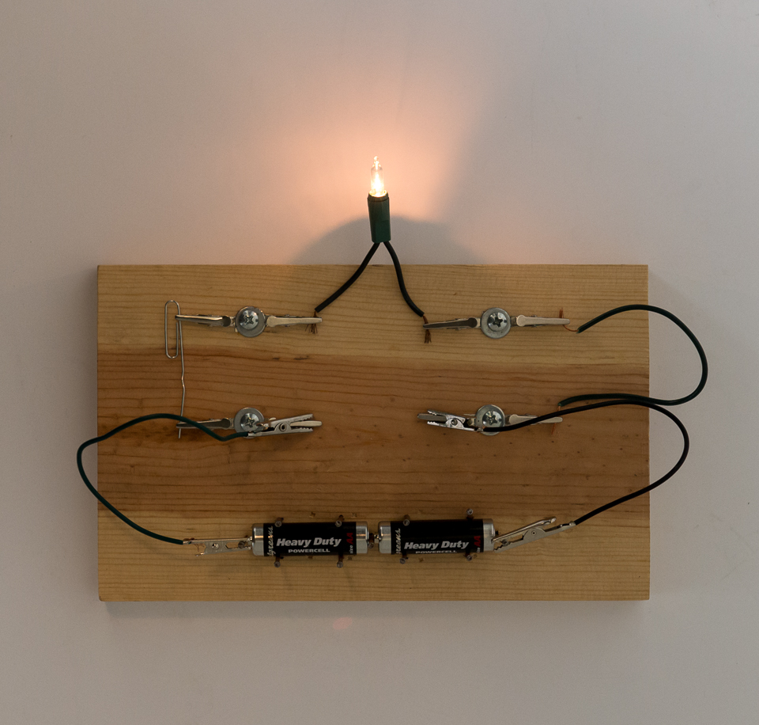
Science - Year 4
Sound and Electricity
Core knowledge and skills
Sound: Identify how sounds are made. Recognise how vibrations travel through ta medium to the ear Find patterns between pitch and the object producing the sound Find patterns between volume and the strength of vibrations Recognise sounds get fainter as the distance from source increases. Electricity: Identify and name the parts of a simple circuit Understand the use and impact of the use of electricity in the modern world Identify ways electricity can be produced.
Discussion Topics and Enquiry Questions
1 | Why is electricity important in modern day life?
2 | Where do we use electricity at home?
3 | How would life be without electricity?
4 | How do you create a simple electric circuit?
5 | Can you name the components of a circuit?
6 | Have you ever wondered how sounds are made?
7 | Do you know what the vocabulary to do with sound means?
Key Vocabulary
pitch | energy
high | bulb
low | break
quiet | wire
loud | connection
Sound wave | conductor
vibration | insulator
battery | generator
source
Oracy Skills
Social Working with others. | Cognitive To ask probing questions
Linguistic To use specialist language to describe their own and others’ talk | Physical To consider movement when addressing an audience.

Slide 2
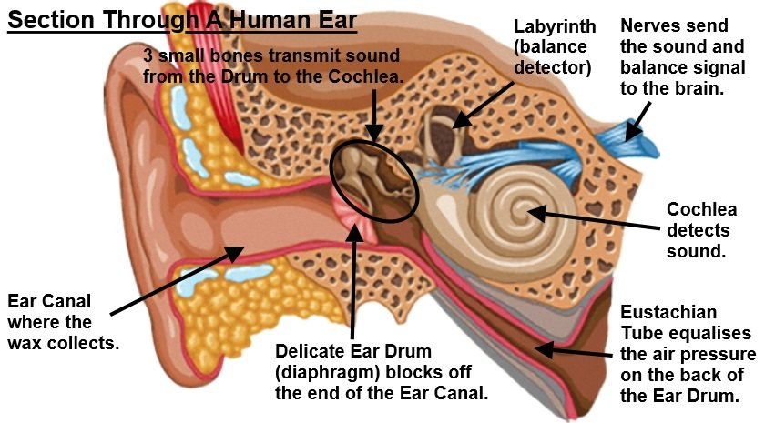
Sticky Knowledge
Understand how electricity works and how it is used in our daily lives. Understand the different ways electricity can be generated. Be able to name the parts of a simple circuit and know their function. Be able to construct a simple circuit and introduce ways to break the circuit. Understand the vocabulary linked to Sound and know the difference between pitch and volume. Understand that the sound gets fainter , the longer the distance from the source. Know that sound needs to travel through a medium and it travels in waves. Know how our ears capture sound waves and how they are transmitted to the brain so we can hear.
Sentence Stems
I agree with… because… I disagree with… because… I would like to challenge the view… Adding onto …’s point… In my opinion… I know this because…
Recommended Reads
American Authors - The Boy who lost his Face by L Sachar.

