Slide 1
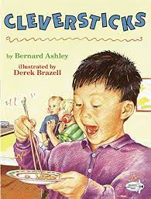
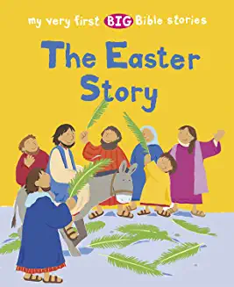
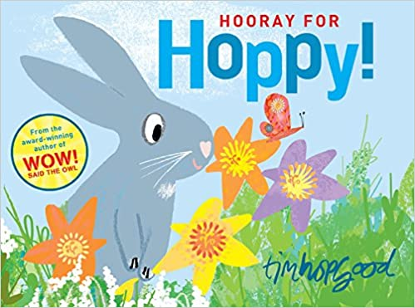
Nursery Knowledge Organiser
Key Texts & Recommended Reads
Core Knowledge & Vocabulary
Everyone is different. We all have special talents. Healthy food choices. | To continue to develop a love of looking at a range of books. To enjoy sharing books with others. | To work out how to plan a ‘Tea Party.’ | Special day for mummy. Card for mummy. Bake a cake. Tea party. | To explore the meaning of Easter. To think of other faiths, beginning of Ramadan. | To think about new life. Enjoy traditions of Easter
Celebration China Nina (story) Food | Book Week Story Poem Non-fiction | Shopping list Food items Shop Money | Special day Plan Shopping list Party | Jesus Easter Ramadan | Easter Bunny Easter card Eggs
Enquiry Questions
What can you see in the shops? Why is your mummy special? Can you find out more about an Easter tradition and why? What comes out of an egg?
Oracy Skills
To make eye contact with the person we are talking to. To listen to the person who is talking to us. To have a conversation in pairs. To say, “I can see because..”

Slide 2
Skills
Personal, Social & Emotional Development
In our interactions with our teachers and friends, we will continue to develop how to be kind and caring towards each other. Through using good hygiene we will learn how ourselves safe from germs. To work together in groups for our cookery activities.
Physical Development
We will continue to develop our large motor skills outside in the garden and using the Trim Trail. We will learn how to take safe ‘risks’ when we are using the equipment in the garden. Trip to Morrisons to buy ingredients for ’Mummy day Tea Party.’
Communication & Language
To continue to learn and recall our six nursery rhymes, supporting our language development. To enjoy sharing familiar books and recalling what happens in the stories. In small groups, describing what we have in our ‘chatterboxes,’ increasing our range of words. Be able to ask each other questions to find out what their friends need or want to play with.
Other Areas
Keep developing painting skills to be able to have more choices in our paintings. Using resources in the art area to develop our imaginative and problem solving skills. Becoming more aware of hearing initial sounds in our names. To be more confident in recognising our name label when we have our snack. During our play, to describe the shapes we can see as we build with the resources.

