Slide 1
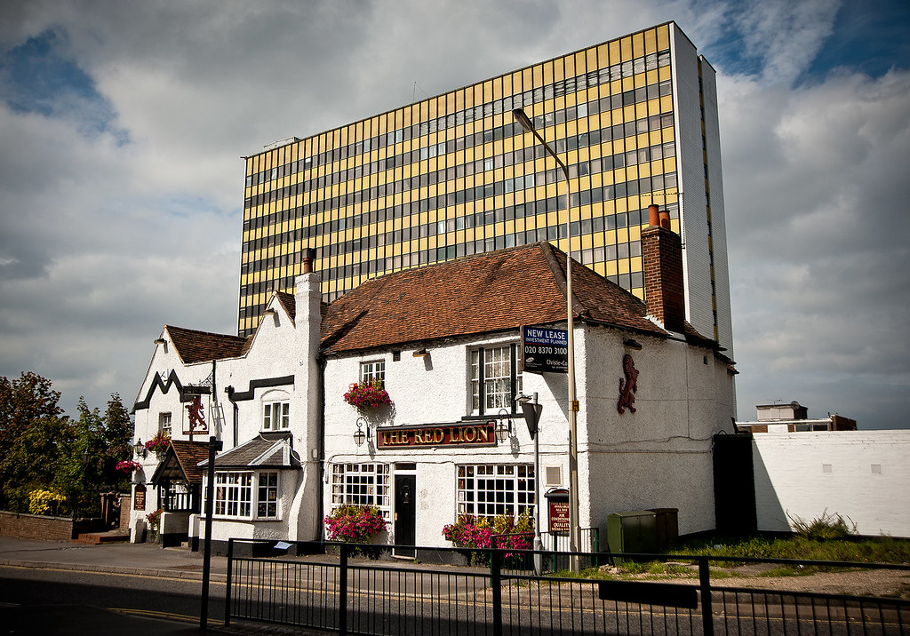
Bracknell – Local Study - Year 4
Core knowledge and skills
Geography: recognise the difference between a settlement, a town, city and country. Understand how settlements change and become towns and cities. Understand what are the physical and Human features in their local area. Understand how human features change in the local area. Be able to produce simple sketch amps. Art/D&T: Learn to sketch from observation. Use line and shade to produce 3D effects in their drawing. Draw buildings and roads in perspective. Design symbols and plans using correct scale.
Discussion Topics and Enquiry Questions
1 | Where is Bracknell?
2 | What did Bracknell look like when it first appeared on a map?
3 | How did Bracknell change over time?
4 | Who came to settle in Bracknell? When did it become a New Town?
5 | What does Bracknell look like today, compared to the original settlement?
Recommended Activities
Walk around their local area taking note of the types of houses and amenities available. Visit parts of the town they have never been to before and compare to local area. Visit green areas in the town and see how they can be used by the people who visit them. Walk to the Look Out and visit the Iron Fort. Think about its location and decide why it was a good spot for an Iron age fort. Visit a town near Bracknell and compare them.
Key Vocabulary
Bracknell | Berkshire
South East | County
Village | Town
City | settlement
Human features | Physical features
Local area | Sketch map
plans | graphs
symbols | links
country | New Town

Slide 2
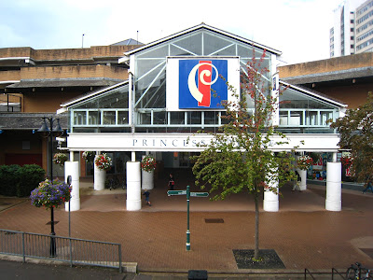
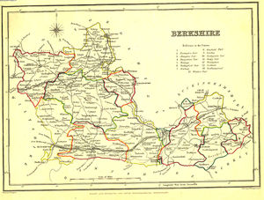
Bracknell - Local Study - Year 4
Sticky Knowledge
Recognise why Bracknell has changed over the years to become a modern town. Understand the chronology involved in these changes. Understand the effect of these changes in the physical features of the area. Understand how humans can affect the area they live in and introduce features in their local environment. Recognise the influence of the different cultures in England and how they reflect in their local area. Understand that Bracknell was a new ton and that brought a big influx of Londoners to live in this part of Berkshire. Understand how they influenced life and culture in the area. Understand that economic development has changed Bracknell. Understand that a local area can be represented by a sketch map and it can include physical, human features. Understand how keys make map reading clear .
Oracy Skills
Social To consider the impact of their words on others when giving feedback | Cognitive To be able to give supporting evidence e.g. citing a text or previous example or historical event.
Linguistic To carefully consider words and phrases they use to express their ideas and how this supports the | Physical To consider movement when addressing an audience
Sentence Stems
I agree with… because… I disagree with… because… I would like to challenge the view… Adding onto …’s point… In my opinion… I know this because…

