Slide 1
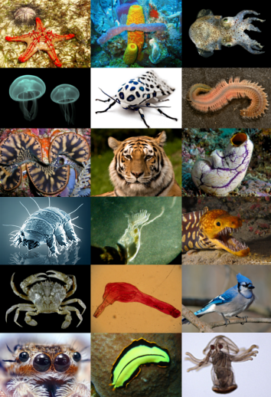
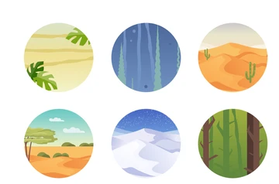
Living Things and their habitats - Year 4
Key Vocabulary
Food chains | Tundra
Habitat | Savannah
Amphibian | Forest/Rain Forest
Mammal | Grassland
Reptile | Desert
Endangered | Seas/Oceans
Adaptation | Food Chains
Classification | Climate
Arctic | Variation
Discussion Topics and Enquiry Questions
1 | How does the environment affect the creatures living in it?
2 | What features are important to decide which living thing is at the top of a food chain.
3 | How do the creatures found in a specific habitat relate to each other? How are they similar? How are they different?
4 | How can changes in the environment affect the living things in that environment?
5 | Are environmental changes permanent? How can they be reversed?
Oracy Skills
Social Working with others. | Cognitive To ask probing questions
Linguistic To carefully consider words and phrases that use to express their ideas | Physical To use pauses for effect in presentation talk

Slide 2
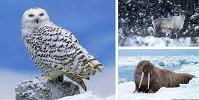
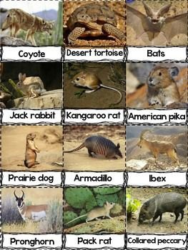
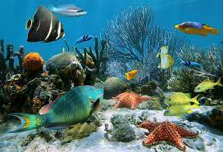
Sticky Knowledge
Recognise that living things can be grouped in a variety of ways. Explore and use classification keys to group, identify and name a variety of living things in their local and wider environment. Recognise that environments can change and that this can sometimes pose danger to living things. Identify similarities and differences or changes relating to processes and environments. Understand food chains and how they relate to the environment living things can be found. Ask relevant questions using different types of scientific enquiring to answer them. Describe and understand key aspects of physical geography, including climate zones, biomes and vegetable belts.
Recommended Reads
Migration by Mike Unwin & Jenni Desmond The Animal Book – A Visual Encyclopaedia of Life on Earth Powered by Plants by Clive Gifford and Gosia Herba The Secret Wild by Alex Evelyn Atlas of Amazing Migrations by Matt Sewell Wild Child by Dara McAnulty Life in the Ocean by Claure A Nivola Swimming with Sharks by Jeanette Winter
Sentence Stems
I agree with… because… I disagree with… because… I would like to challenge the view… Adding onto …’s point… In my opinion… I know this because…

