Slide 1
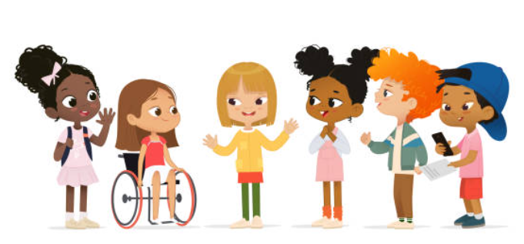
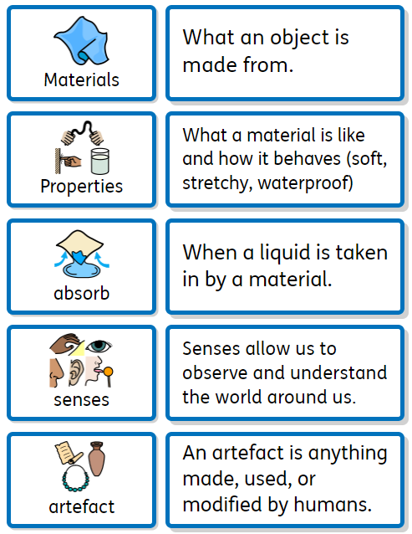
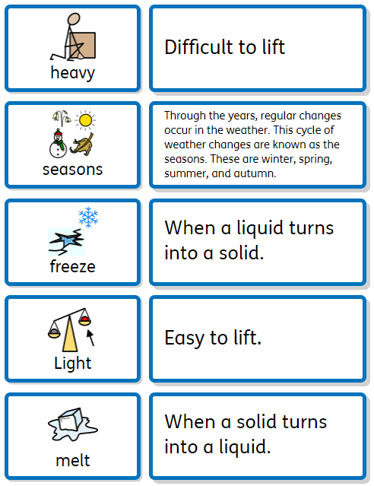
Y1 Significant Me! What makes me, me?
Discussion Topics and Enquiry Questions
1 | Can you make sounds louder/ quieter?
2 | How do you know if an object is floating/sinking?
3 | Do you need all your senses?
4 | Are all materials the same?
5 | Have toys always been the same for children?
Sentence Stems
I agree with… I disagree with… I can see… I know…
Recommended Reads
Oracy Skills
Social To take turns in group discussions with their peers To listen to others. | Cognitive To explain ideas and events.
Linguistic To use vocabulary appropriate to the specific topic at hand. To take opportunities to try out new language, even if it is not always used correctly. | Physical To speak clearly and confidently in a range of contexts To use gestures to support meaning in your talk or play.
Key Vocabulary

Slide 2
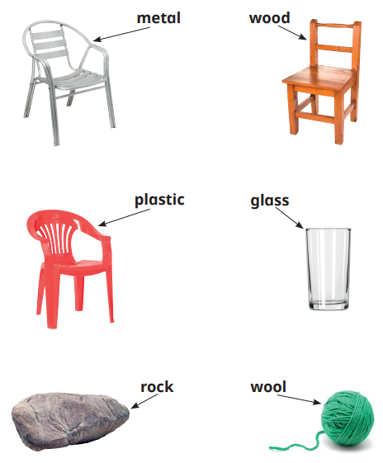
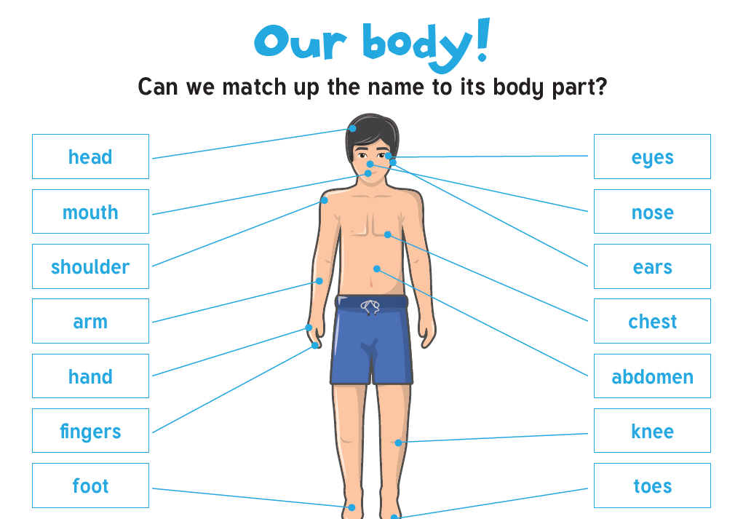
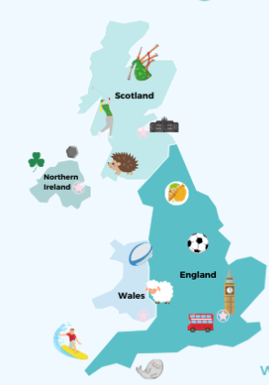
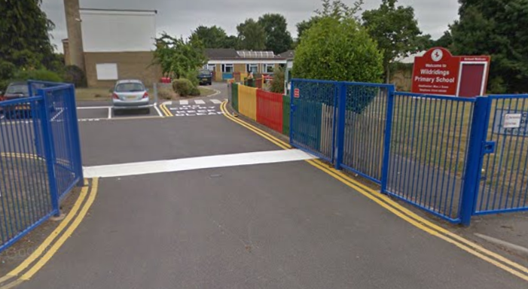
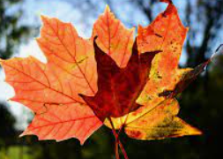
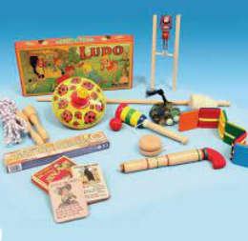
Sticky Knowledge
Geography: Our school environment
To identify the human and physical features in their school environment. To use basic mapping skills to record a route.
Science: Animals and Humans
To name the basic parts of the human body. To know that we have five senses: sight, hearing, touch, taste, smell and identify body parts associated with our senses. To understand that we can take care of our bodies by maintaining a balanced diet and exercising regularly.
Geography: Locate countries in the UK
Children to find England, Scotland, Northern Ireland and Wales on a map of the United Kingdom. Children to name the capital cities: England- London Wales- Cardiff Scotland- Edinburgh Northern Ireland- Belfast
Science: Weather and Seasons
To recognise seasonal changes and the observe changes over time. Children will know that: In autumn the amount of time it is light becomes less which means it gets darker earlier. The leaves start to change colour and fall off the trees.
Science: Materials
Describe the simple physical properties of a variety of everyday materials. Identify and name a variety of everyday materials, including wood, plastic, glass, metal, water and rock. Compare and group together a variety of everyday materials on the basis of their simple physical properties
History: Changes over time
To compare toys and games played now and in the past. To ask questions to find out about the toys their parents and grandparents enjoyed playing with. To look at how transport has changed over time. What similarities and differences can the children notice?

