Slide 1
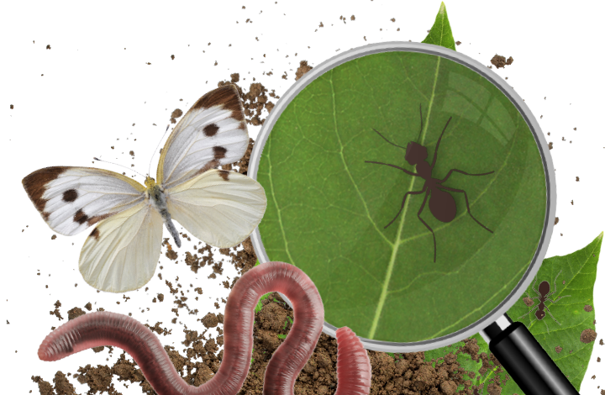
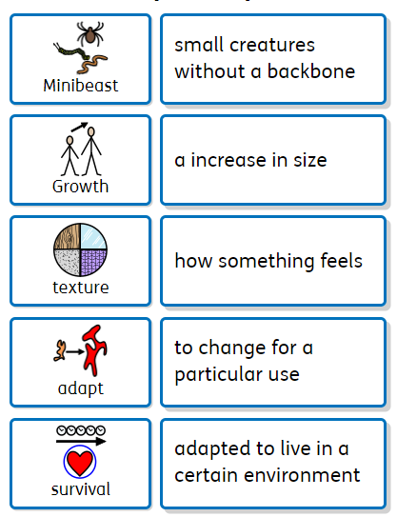
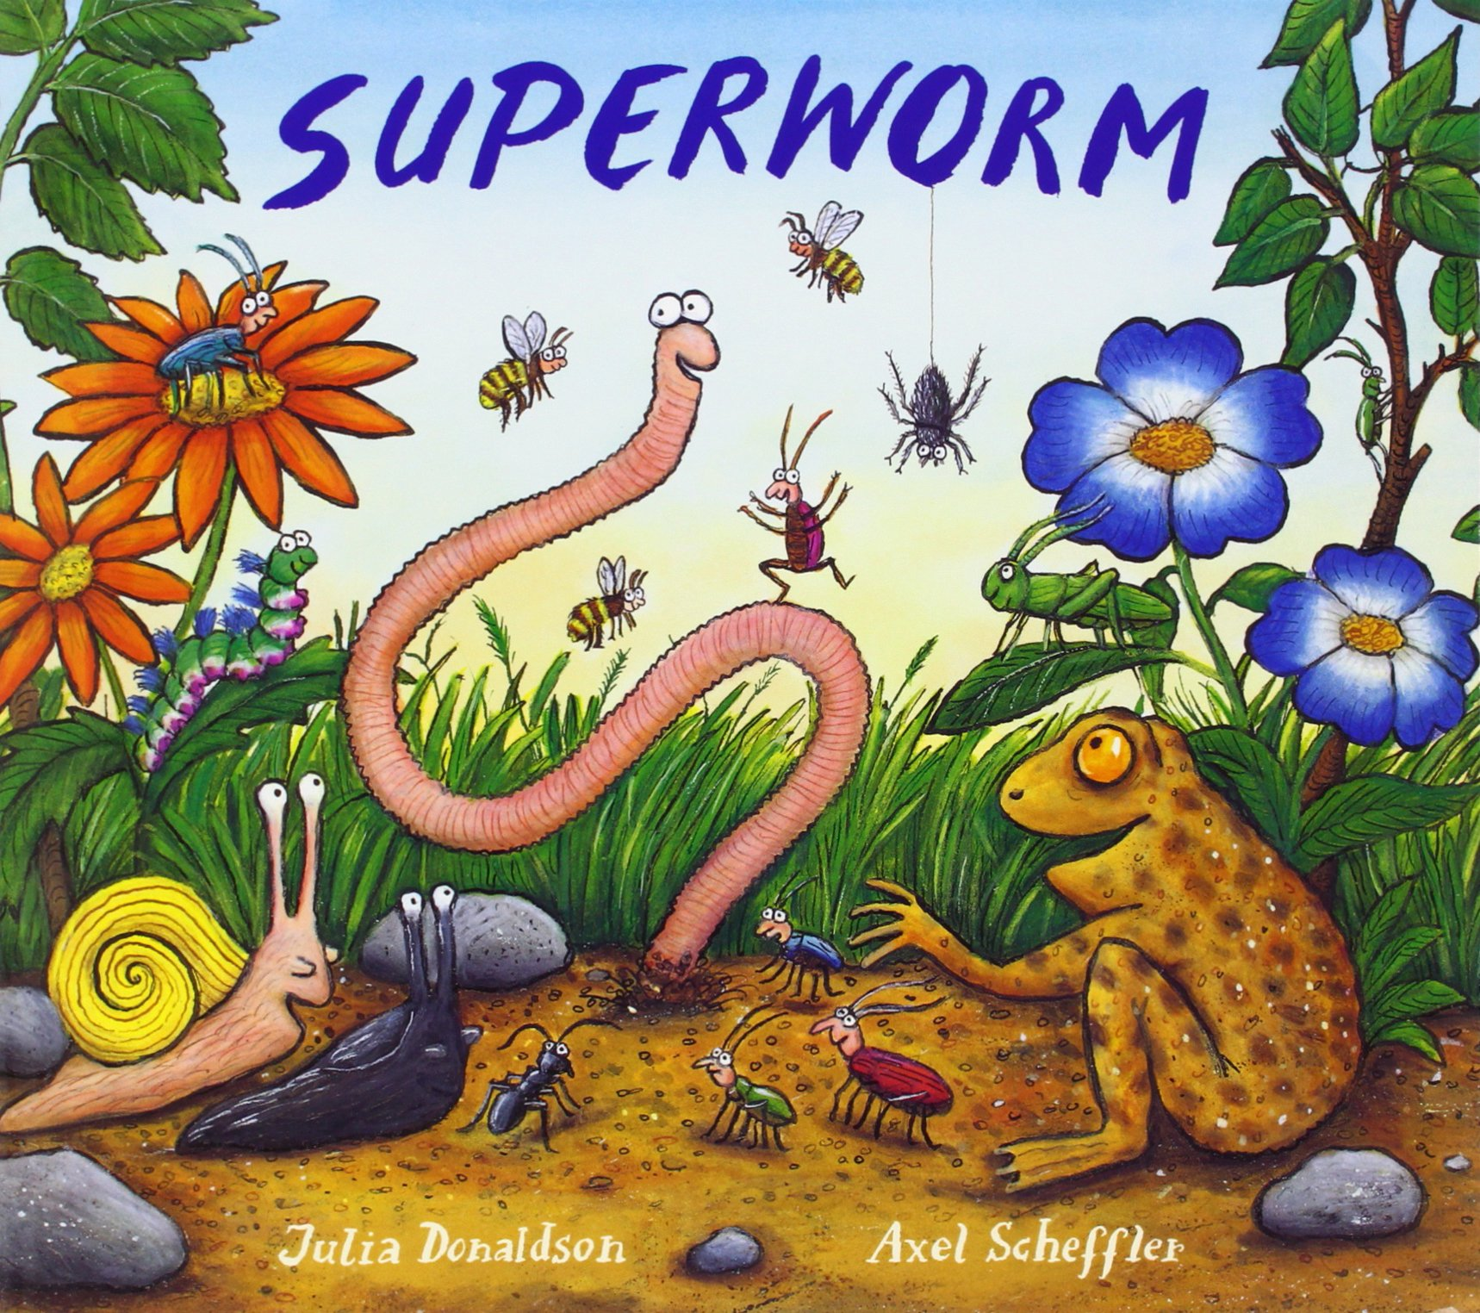
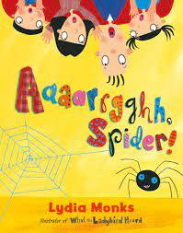
Key Vocabulary
A Bugs Life
Discussion Topics and Enquiry Questions
1 | Where does our food come from?
2 | What is the life cycle of a butterfly?
3 | What other mediums can we use to create art?
4 | How do minibeasts avoid being eaten?
5 | How do plants adapt to their environment?
Oracy Skills
Social To confidently present a pre-prepared presentation To develop an awareness of the audience | Physical To start using gestures to support ideas.
 | Cognitive To challenge someone else’s opinion politely. To make what they are saying more exciting for the audience To make connections between what has been said and their own experiences
Linguistic To use technical and specific vocabulary. To know when to speak differently for a different audience
Recommended Reads
Superworm is long, strong and has a big heart! | This spider wants to be a pet! | Look at a variety of different foods

Slide 2
Prior Knowledge
Different animal groups The continents and their locations Life cycles of different animals Weather patterns What a habitat is
Key Skills
Observing and describing Identifying and naming Designing and making Printing Sculpting Preparing food Preform a simple test
Sticky Knowledge
Understand where our food comes from Understand where plants grow around the world Understand the life cycle of a butterfly Understand how the weather changes based on the location in relation to the equator Understand how plants and animals adapt to live in their environment Understand a healthy lifestyle Know about the art of Guiseppe Arcimbaldo Understand how a food chain works
Sentence Stems
I agree with… I disagree with… I would like to challenge… It happens because… I wonder…

