Slide 1
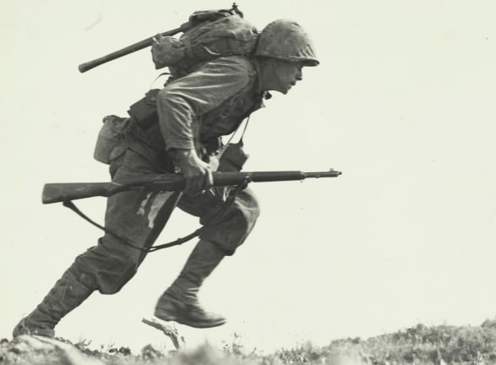
World War 2
Discussion Topics and Enquiry Questions
1 | Is war a justifiable act?
2 | What was the catalyst that started World War 2?
3 | What was Britain like during World War 2?
4 | How did Britain change as a result of World War 2?
5 | What was the impact of key events such as the holocaust and Battle of Britain?
6 | How were children impacted during the war?
Key Vocabulary
Allied | Axis | Anderson | Battle of Britain | Evacuation | Evacuee
Invasion | Blitz | Nazi | Jew | Propaganda | Rationing
Soviet Union | Victory | Treaty of Versailles |  | United Nations | Alliance
Sentence Stems
I agree with… because… I disagree with… because… I would like to challenge the view… Adding onto …’s point… In my opinion… I know this because…
Oracy Skills
Social To be able to present information fluently and confidently | Cognitive To construct a detailed argument and respond to more complex questioning
Linguistic To respond using sophisticated sentence stem and give evidence support their suggestions | Physical To respond positively to others who may disagree with our opinions
Recommended Reads
Goodnight Mister Tom- Michelle Magorian Once – Morris Gleitzman Anne Frank: The Diary of a Young Girl – Anne Frank The Boy in the Striped Pyjamas – John Boyne

Slide 2
Core knowledge and skills
History: To understand the cause and effect of World War 2 on Britain. To recognise that World War 2 created changes across the country. Explore the reasons for Britain’s involvement in WW2. Recognise different countries involvement. Consider impact of war on different groups (particularly children). To understand what causes conflict and how resolution works. What makes an effective leader. Geography: To locate cities that were significant during the war and establish what physical and human features they had. Explain why certain areas were seen as ‘safe’, while others not. Understand which countries were involved in WW2 and their geographic locations around the world (how this made crossing borders and invading countries more difficult or easier). Science: To understand what living things need to survive. Be able to group and classify different organisms and microorganisms. Construct and draw series circuits. Look at complete and incomplete circuits and variations within circuits. Plan and carry out a voltage experiment.

