Slide 1
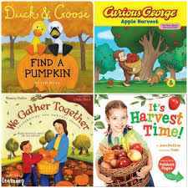
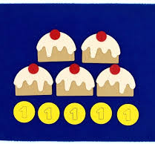
Nursery Knowledge Organiser
Key Texts & Recommended Reads
Core Knowledge & Vocabulary
To explore and enjoy a new setting. To form new friendships. To begin to learn I can do things for myself. | To find out how we can help others. To learn about the roles of a doctor and nurse. To learn how to plan an event. | To enjoy decorating cakes to sell at the Bake Sale and raise money for a charity. | To discover why we celebrate harvest. Discovering the different types of food that grow. What is the role of a farmer? | To learn how to bake bread. To come together and enjoy eating the bread with our friends. To think of others. | To think about how I have grown since being a baby. To begin to describe what I look like and learn about my body. | To discover our similarities and differences. To enjoy finding out about the cultures in our Nursery.
Nursery Friends. Play. | Poorly. Charity. Bake Sale. | Shopping list Food items Posters Money | Special event Harvest songs. | Ingredients. Dough. Bread. | Display our portraits for our family to see. | I like/do not like… Country.
Enquiry Questions
How do you feel about going to play in Nursery? How can we help children who are poorly? What would you decorate your cake/biscuit with and why? How could you celebrate Harvest at home? Who ls in my family?
Oracy Skills
To learn what actions make a good listener. Make eye contact with the person we are talking to. To listen to the person who is talking to us. To say, “I can see because..”

Slide 2
Skills
Personal, Social & Emotional Development
To enjoy exploring our new environment and discovering the toys and equipment we can play with. To make new friends and enjoy playing with our friends. To begin to learn how to take turns and share the toys we are playing with. We are discovering how to be more independent when washing our hands, putting on our coats to go outside.
Physical Development
We are beginning to learn how our arms and legs support us when we climb on the outdoor resources in the garden. We are beginning to learn how to take safe ‘risks’ when we are using the equipment in the garden. Through the opportunities and experiences provided in Nursery, we will learn how to mark make and create lines and circles.
Communication & Language
By learning the Nursery routines, it will help us to develop our sequencing skills. As we sing songs and nursery rhymes, we will develop our listening skills. When we clap out our names, we will hear what our names sound like. To specifically learn 3 new nursery rhymes and recall them, supporting our language development. To enjoy sharing familiar books and talking about what we see in the pictures. As we play, our teachers will comment, describe and engage in conversations with us. This will increase our communications skills with others and support us in learning a wider range of vocabulary.
Other Areas
To enjoy exploring the Nursery garden beginning to notice the changes from summer to autumn. To begin to explore and enjoy creative activities, such as painting and playing with the play-dough. We will develop our cutting skills by tearing paper and starting to learn how to use scissors.

