Slide 1
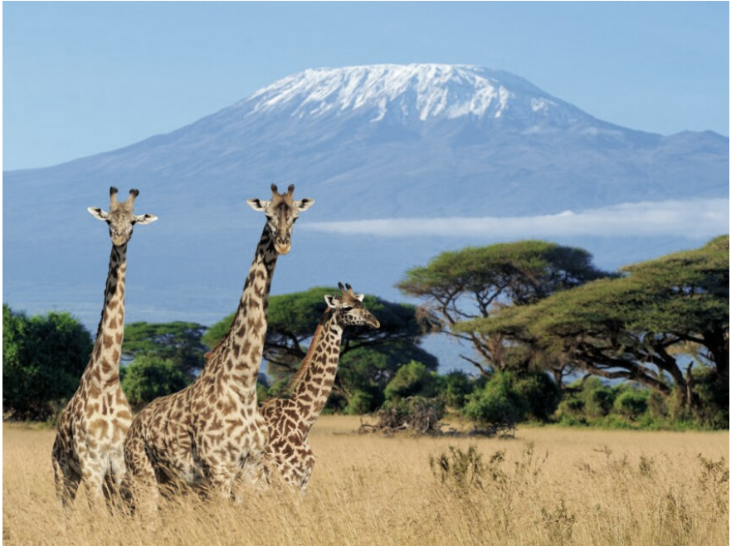
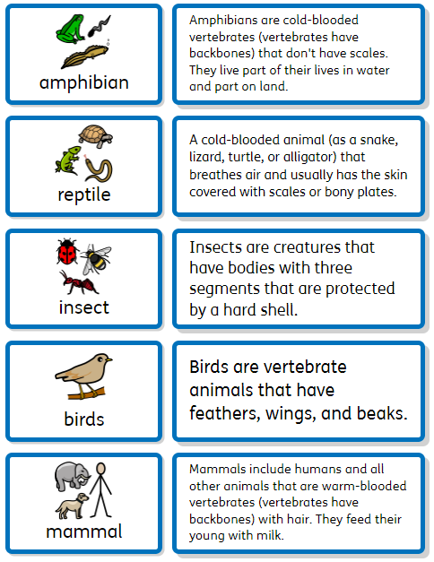
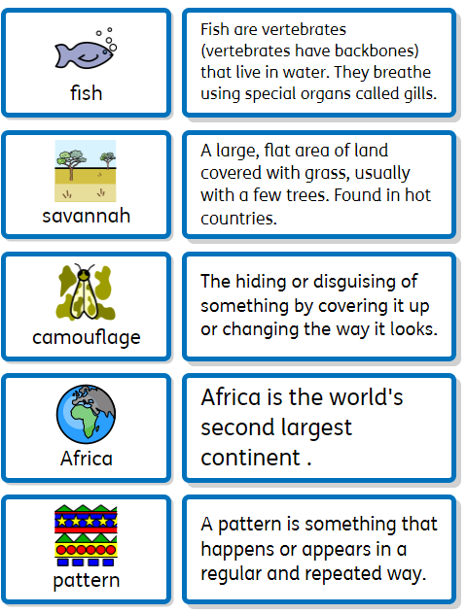
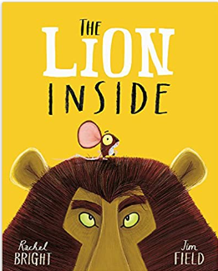
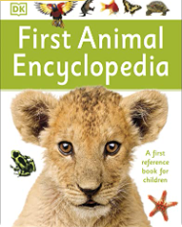
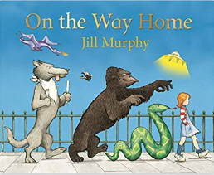
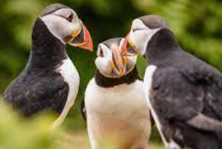
Y1 Wild About Animals
Are some animals the same?
Key Vocabulary
Discussion Topics and Enquiry Questions
1 | What animal groups can you name?
2 | Can you tell me about the different groups?
3 | Can you hide a butterfly in common sight?
4 | If I woke up in Kenya, would it look the same?
Oracy Skills
Social To take turns in group discussions with their peers To listen to others and be willing to change their mind based on what they have heard. | Cognitive To be able to challenge someone else’s opinion or disagree politely To explain ideas and events in a logical order.
Linguistic To use vocabulary appropriate to the specific topic at hand. To use conjunctions to organise and sequence ideas e.g. firstly, then, finally. | Physical To use the appropriate tone and volume of voice in different situations To use expression when speaking and reading
Recommended Reads
Sentence Stems
I agree with… I disagree with… I can see… I know… I wonder… What if…

Slide 2
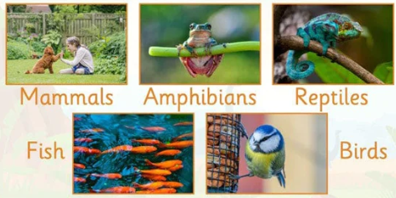
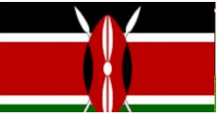
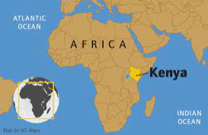
Science
To identify and name a variety of common animals including fish, amphibians, reptiles, birds and mammals Fish live in water. They have fins instead of legs and gills instead of lungs. They lay their eggs in water. Amphibians - live on land and in water. They lay their eggs in water. Reptiles- live in water and on land. They have scales and are cold blooded. This means that they cannot keep warm by themselves and need to be in a warm place. They lay their eggs on land. Birds have a beak, wings, feathers and 2 legs. Mammals usually have hair or fur. Mammal babies are born alive. The mothers feed their babies milk. We are mammals.
Geography
Compare Bracknell and Nairobi. Compare- landscapes (human and physical features), wildlife, lifestyle, weather, transport and leisure. Bracknell, England The UK is made up of England, Wales, Scotland and Northern Ireland. Bracknell is a town in Berkshire, England England's bustling capital is London. England has 24 native types of mammal, including badgers, foxes and deer. Bracknell is home to different types of animals including: birds, stag beetles, deer, great crested newts. Two rivers run through Bracknell (River Blackwater and the Cut) Forests areas, parks and countryside cover Bracknell and there are lots on Local Nature Reserves Nairobi, Kenya Kenya is a country is part of the continent of Africa. The landscape includes: the savannah (mixed grassland and woodland) low coastal plains on the Indian Ocean and mountains. Most Kenyans live in the highlands, where Nairobi, the capital is. English and Swahili are spoken here. School is free in Kenya, but many children are too busy to go to classes. They help their families by working the land, tending cattle, cooking, or fetching water. In Nairobi school is compulsory and starts at the age of 6. Nairobi hosts many businesses. Music and storytelling are important parts of Kenyan culture. For centuries, tribes throughout the country have used songs, stories and poems to pass on their beliefs, history, and customs. Nairobi is unique as it is the only city with a National Park inside. Some of the animals that inhabit here include: elephants, lions, cheetahs, giraffes, zebras, hippos, rhinos, zebras and more.

