Slide 1
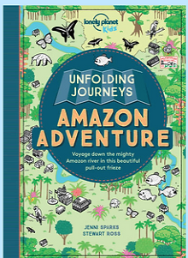
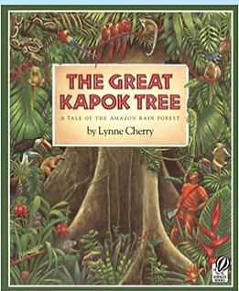
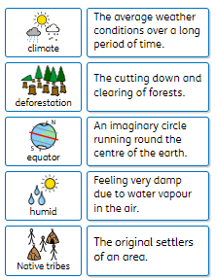
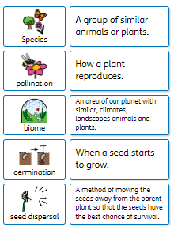
Amazing Amazon
Year 3
Recommended Reads
Oracy Skills
Social To speak with confidence in front of an audience. To make sure that everyone in the group makes a contribution. | Cognitive To make what they are saying more exciting for the audience. To be able to summarise a discussion.
Linguistic To use specialist vocabulary and make precise vocabulary choices. | Physical To deliberately vary the tone of voice in order to convey meaning.
Why is the rainforest so important?
Core knowledge and skills
Comparing the climate in the Amazon with the climate in the UK. Develop our geographical knowledge to include, biomes, equator, lines of longitude and latitude and the Northern and Southern Hemisphere. What different plants need to survive and how they reproduce. How rivers are used and why people settle near them. Recognise the different properties of soils.
Key Vocabulary
Sentence Stems
I have learnt that… The evidence suggests…. In comparison….. In my opinion……
Discussion Topics and Enquiry Questions
1 | Where are the rainforests and why are they located near the equator?
2 | What is the impact of deforestation?
3 | What is life like in the Amazon compared to the UK?
4 | What at the parts and functions of plants?
5 | How can we use renewable sources of energy?

